Slide 1

This practical class needs to be divided into groups, please make a group of 1~3 people.
https://www.shutterstock.com/zh-Hant/image-vector/icon-people-vector-727689157

Slide 2
Data Analysis and Machine Learning by Using Spark Environment in Google Colab
Johnny, Jing-Chun Zhan (詹景淳)
Notes:
Welcome to the big data Technology and Administration course.
In this course, we will introduce the simple method for data analysis, such as data visualization and machine learning by using Spark environment in google colab.

Slide 3
Outline
Introduce the Operations in Google Colab
Natural Language Processing in Spark
Predicting Apple’s Stock Price by Using Keras
Real Estate Value Prediction with XGBoost
Notes:
And this is our outline, we first will briefly Introduce the Operations in Google Colab
Then, we will go to the implementation part:
First, is how to do the Natural Language Processing in Spark
Second, we will teach you how to Predict Apple’s Stock Price by Using Keras.
Last, is the part of Real Estate Value Prediction with XGBoost.

Slide 4

Google Colab
Before we start coding, we should know how to use Colab.
Colab allows you can write & run python code online.
Colab provides free GPU resources for Machine learning (ML) and model training.
https://clay-atlas.com/blog/2019/09/29/colab-chinese-tutorial/

Slide 5
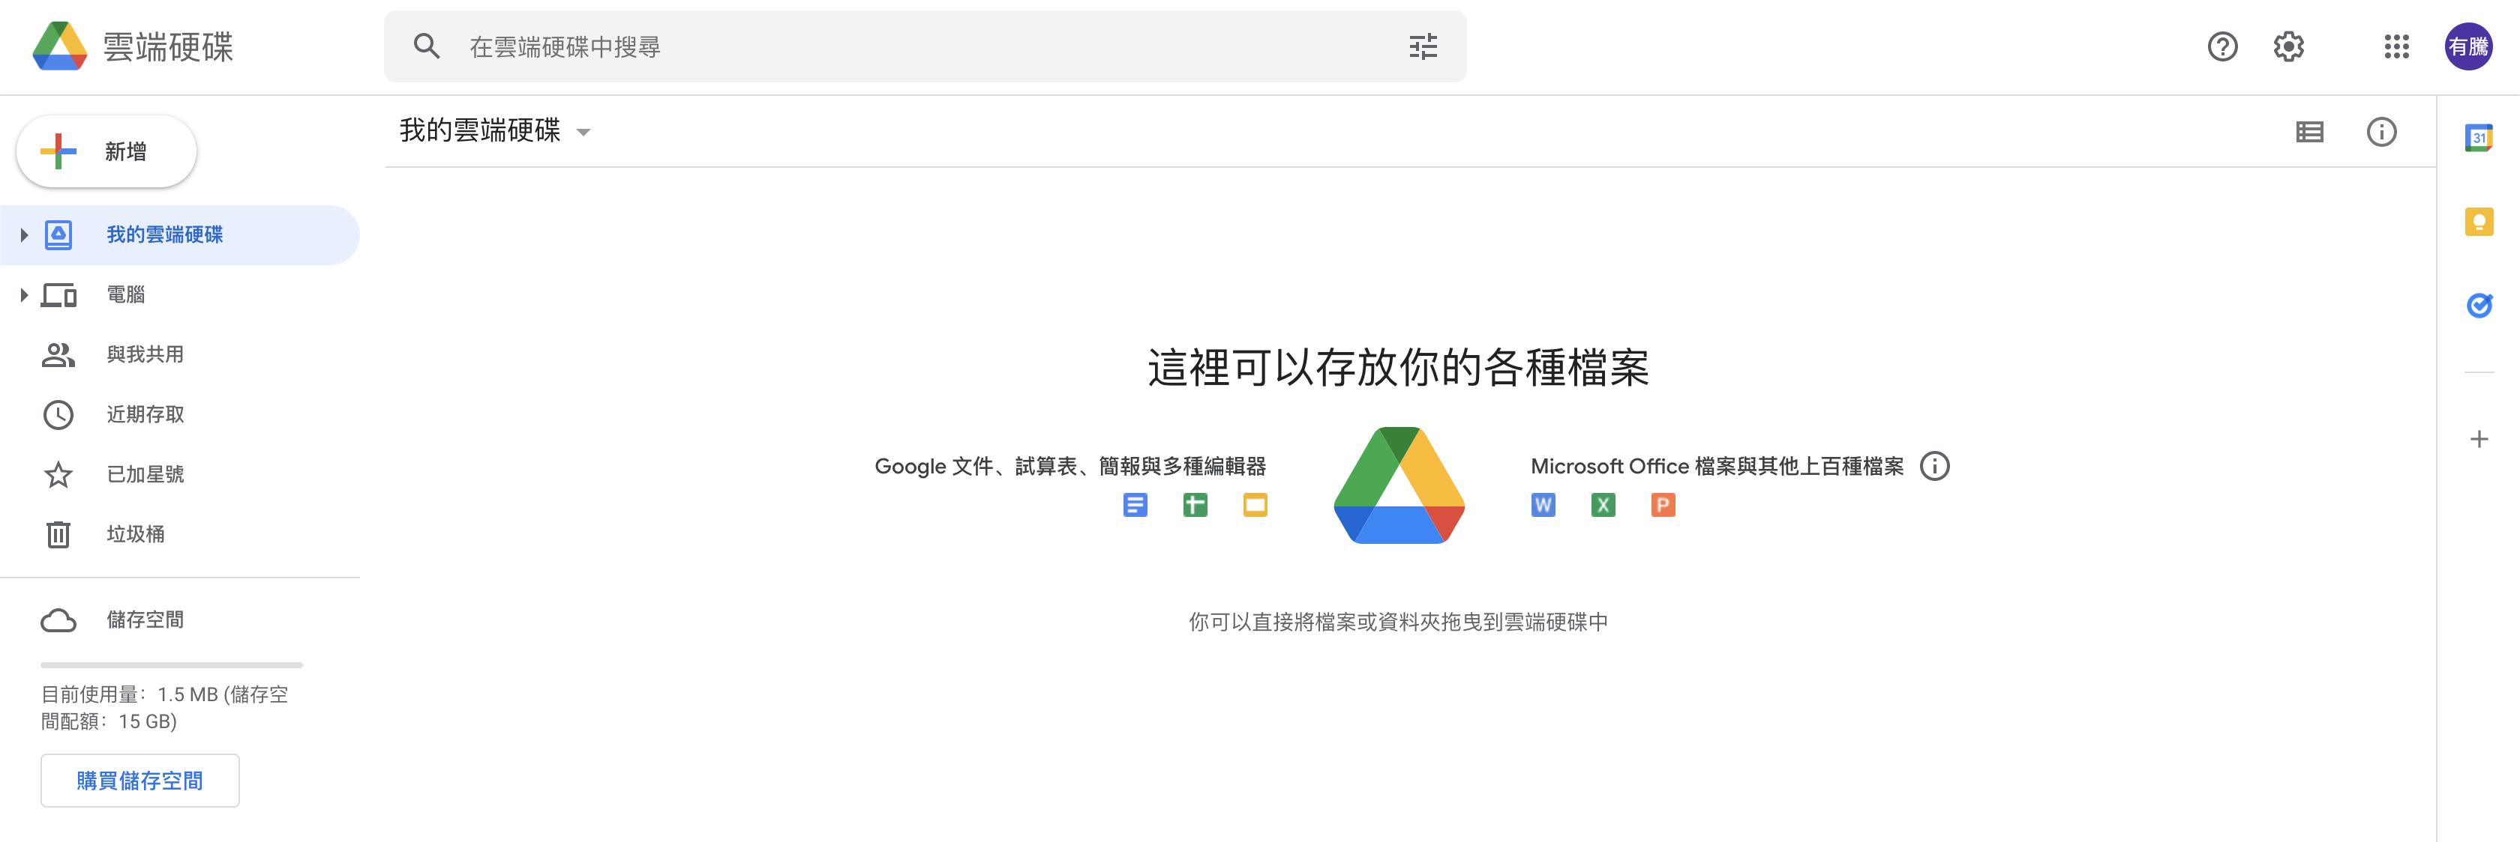
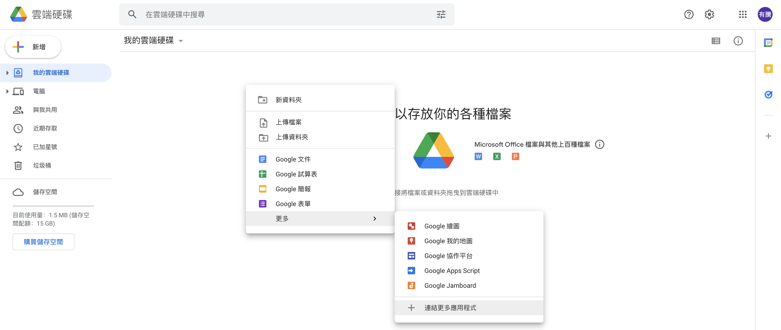
Connect Colab into Google Drive
We should connect Colab into google drive before we use it.
Right Click
Notes:
The steps are as the following figure.

Slide 6
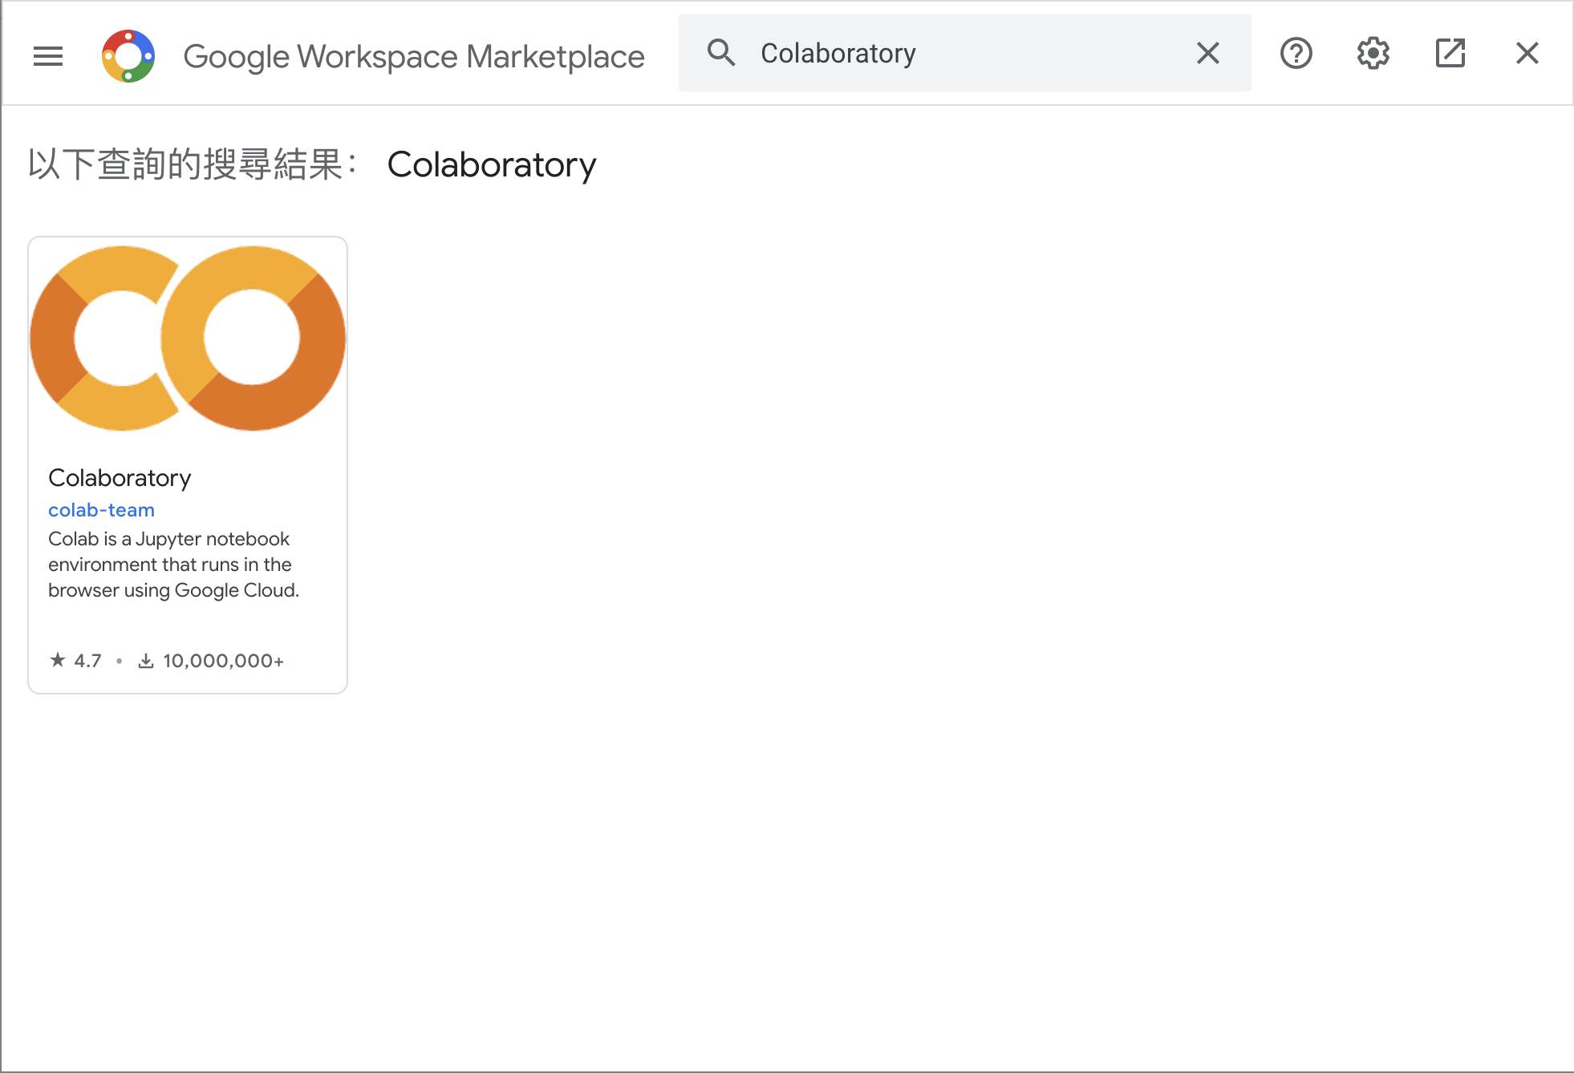

Connect Colab into Google Drive (Cont’d )
Search Colab and install it.

Slide 7
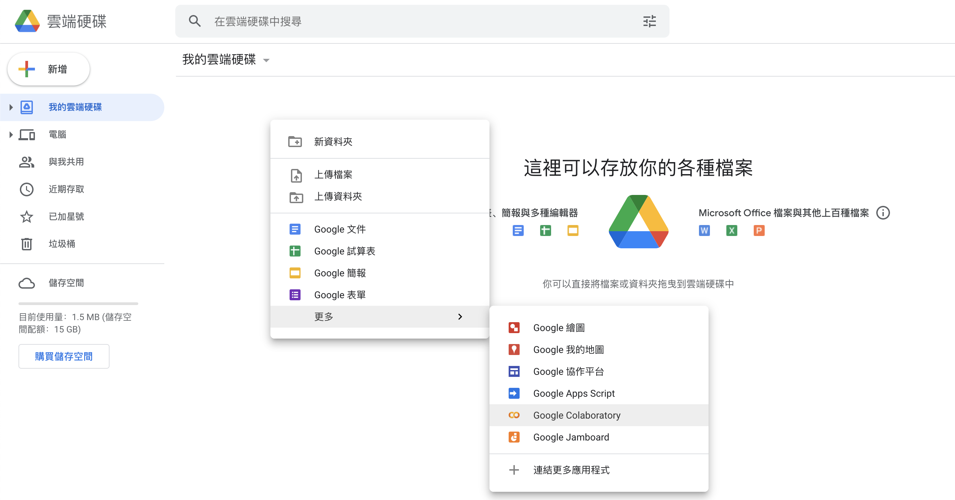
Connect Colab into Google Drive (Cont’d )
After installation, you can create a new Colab notebook.
Notes:
The steps are as the following figure.

Slide 8
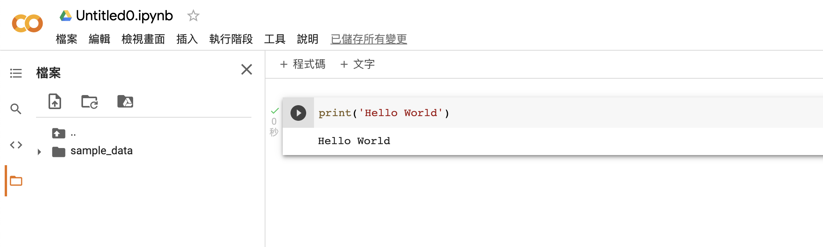
Colab User Interface (UI)
Notebook name
Python code
Code cell
Files
Output
Execute button
Notes:
This page is a description of the colab user interface.

Slide 9
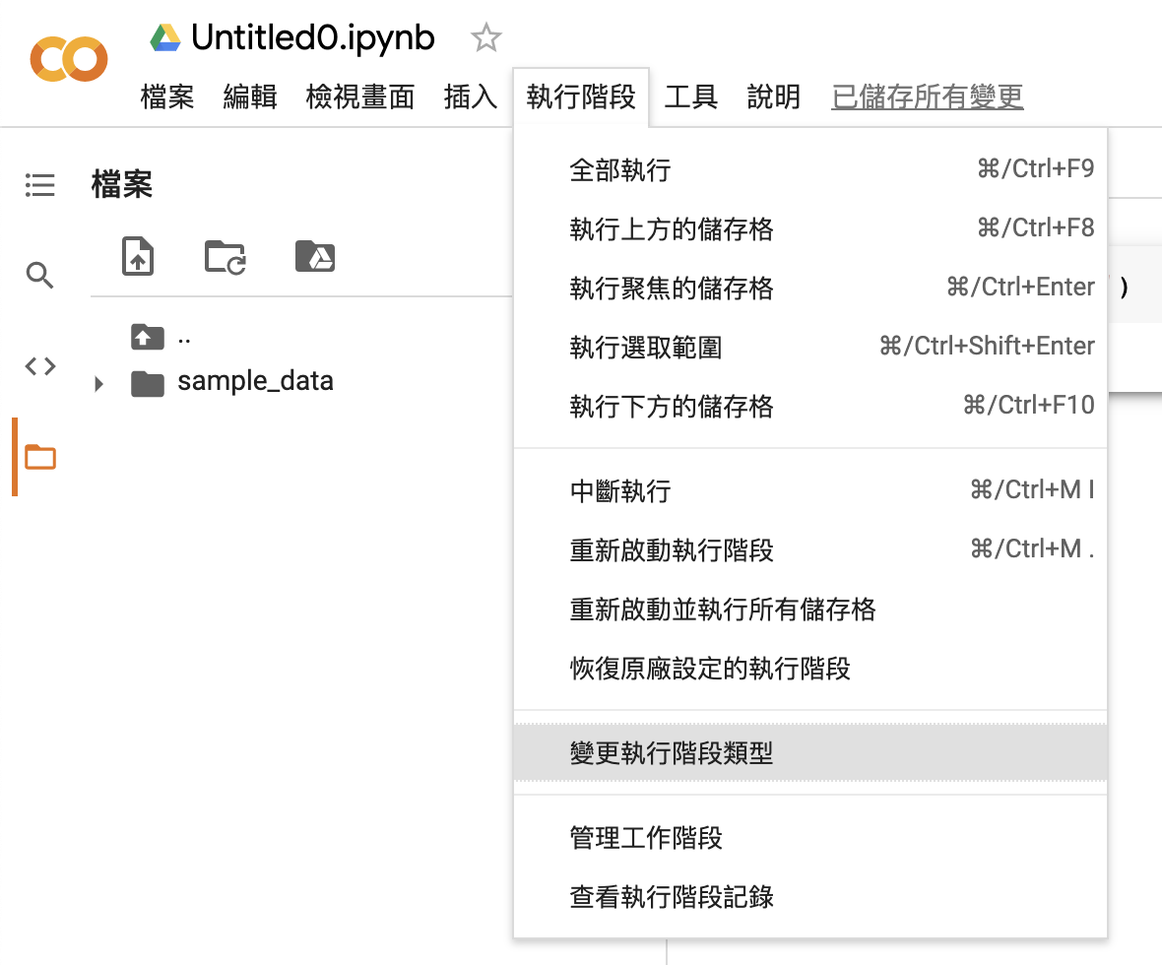

Change to Use GPU
We can change to GPU hardware accelerator.
Notes:
The steps are as the following figure.

Slide 10
Natural Language Processing in Spark
Use NLP to find the bullies lurking behind the Internet.
Notes:
Next, we will enter the practical section.
In fact, in a recent case in Spain where a student at a school was cyberbullied through a social media account, the impact on the student’s mental health was so severe that the school began to investigate. The school contacted researchers who were able to use NLP methods such as TF-IDF to help identify several potential sources of bullying. Eventually, a list of potential students was submitted to the school, and when confronted with the real suspects, they admitted to being the perpetrators.
事實上，最近在西班牙發生了一起案例，學校的一名學生通過社交媒體賬戶受到網絡欺凌，這對學生的健康產生瞭如此嚴重的影響，以至於校方開始參與調查。學校聯繫了研究人員，他們能夠使用 TF-IDF 等 NLP 方法幫助確定霸凌的幾個潛在來源。最終，潛在學生的名單被提交給學校，當面對真正的嫌疑人時，他們承認自己是肇事者。

Slide 11
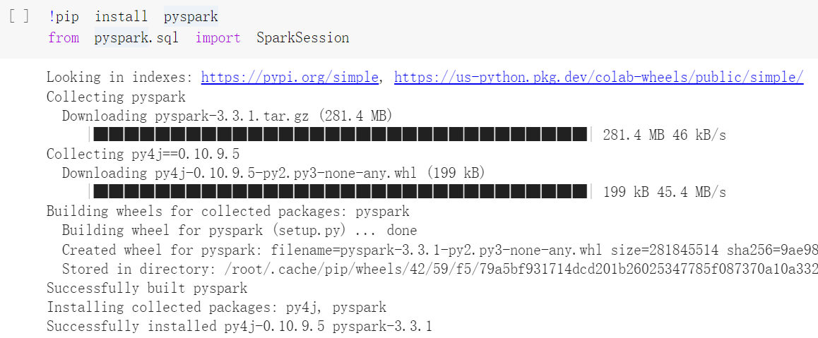
Install Pyspark on Colab
Install PySpark on Colab with !pip install pyspark.
Input from pyspark.sql import SparkSession to import and initialize SparkSession when executing Spark.
Notes:
Install PySpark on Colab with !(exclamation mark ) pip install pyspark.
首先我們要再colab上安裝PySpark
並且import SparkSessiony，再執行Spark時導入並初始化SparkSession

Slide 12
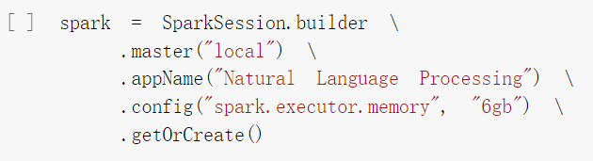
SparkSession
master(“local”): Set the Spark master URL to connect to, and “local” means to run locally.
appName(): Set a name for the application.
Config(): Configure 6 GB of space for spark.executor.memory.
getOrCreate(): Get an existing SparkSession or creates a new one based on the options set in the builder.
Notes:
Configure SparkSession with a variable named spark by using the following script:
master(): Set the Spark master URL to connect to, and peremeter “local” means to run locally.
appName(): Set a name for the application.
Config(): Configure 6 GB of space for spark.executor.memory.
getOrCreate(): Get an existing SparkSession or creates a new one based on the options set in the builder.
使用以下程式碼，定義名為 spark 的變量，並為其配置 SparkSession：
master()：設置要連接的Spark master URL，peremeter“local”表示在本地運行。
appName()：為應用程序設置一個名稱。
Config()：為spark.executor.memory配置6GB空間。
getOrCreate()：獲取現有的 SparkSession 或根據構建器中設置的選項創建新的 SparkSession。

Slide 13
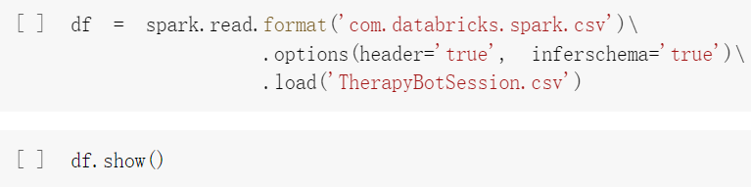
Create the Dataframe
Dataframe (df) is created by reading the CSV file (TherapyBotSession).
option(header=‘true’): Treat the first line of the CSV file as field names.
option(inferschema=‘true’): Spark will automatically go through the CSV file and infer the schema of each column.
Notes:
Next, we assign the dataset to a dataframe in Spark, called df.
The contents of the dataset can be seen by clicking on TherapyBotSession.csv on the repository as seen in the following screenshot:
option(header=‘true’): Treat the first line of the CSV file as field names.
option(inferschema=‘true’): Spark will automatically go through the CSV file and infer the schema of each column.
Once the dataset is downloaded, it can be uploaded and converted into a dataframe, df. The dataframe can be viewed by executing df.show(), as seen in the following screenshot:
接下來，我們將讀取CSV檔案中的數據，並分配給 Spark (中的數據框架)，稱為 df。
數據框 (df) 是通過讀取 CSV 文件 (TherapyBotSession) 創建的。
option(header=‘true’)：將 CSV 文件的第一行視為字段名稱。
option(inferschema=‘true’)：Spark 將自動遍歷 CSV 文件並推斷每一列的型態。
讀取數據集後，可以通過執行 df.show() 查看數據框，如以下屏幕截圖所示：

Slide 14
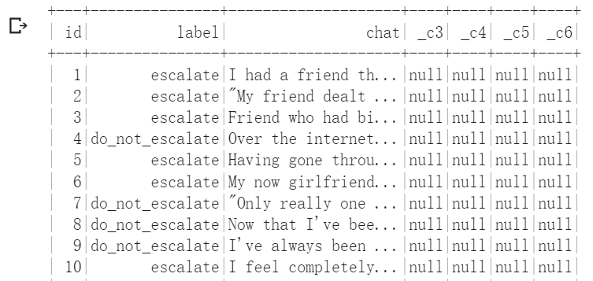
Create the Dataframe (Cont’d)
A part of dataframe is shown below.
Notes:
The output of the script can be seen in the following figure:

Slide 15
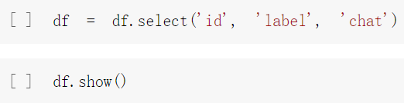
Remove Redundant Data
The dataframe, _c3, _c4, _c5, and _c6 that can be excluded from the dataset using the following script.
Use select() to choose the subset of a dataframe.
Notes:
There are 3 main fields that are of particular interest to us from the dataframe:
id: the unique id of each transaction between a visitor to the website and the chatbot.
2. label: since this is a supervised modeling approach where we know the outcome that we are trying to predict, each transaction has been classified as either escalate or do_not_escalate. This field will be used during the modeling process to train the text to identify words that would classify falling under one of these two scenarios.
3. chat: lastly we have the chat text from the visitor on the website that our model will classify
The dataframe, df, has some additional columns, _c3, _c4, _c5, and _c6 that will not be used in the model and therefore, can be excluded from the dataset using the following script:
數據框 df 有一些額外的列 _c3、_c4、_c5 和 _c6，它們不會在模型中使用，因此可以使用以下腳本從數據集中排除：

Slide 16
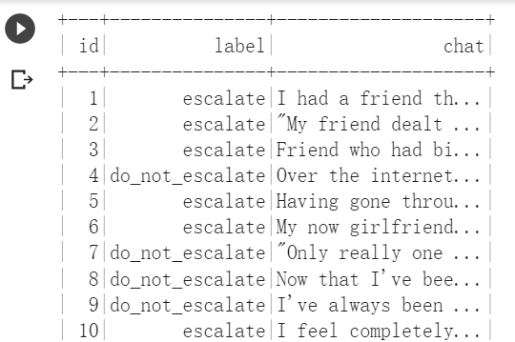
Remove Redundant Data (Cont’d)
A part of dataframe is shown below.
Notes:
After removing The output of the script can be seen in the following figure:

Slide 17
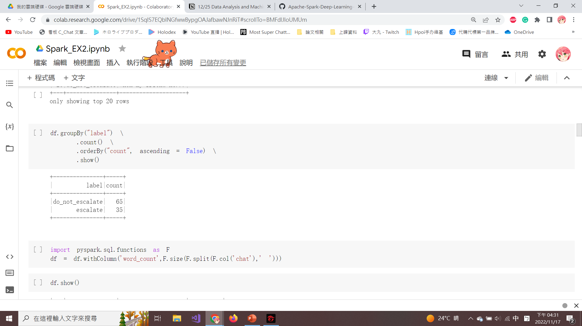
Ordering of Dataframe
groupby(): Group the label column and generate a count distribution.
orderby(“count”): Sort the dataframe by column counts.
“ascending=False”: The column is sorted in descending order.
Notes:
Execute the following script to group the label column and to generate a count distribution
groupby(): Group the label column and generate a count distribution.
orderby(“count”): Sort the dataframe by column counts.
“ascending=False”: The column is sorted in descending order.
We can see that there is a 65:35 distribution of do_not_escalate to escalate as seen in the following screenshot:
接下來我們進入資料前處理的步驟，執行以下程式對標籤列進行分組並生成計數分佈

Slide 18
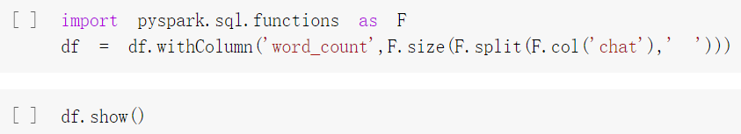
Create word_count Column
A new column (word_count) is created to calculate how many words are used in each of the 100 transactions.
withColumn(): Add a new column to dataframe.
size(): Calculate how many words are in each ‘chat’ column.
Notes:
Add a new column, word_count, to the dataframe, df, using the following script:

Slide 19
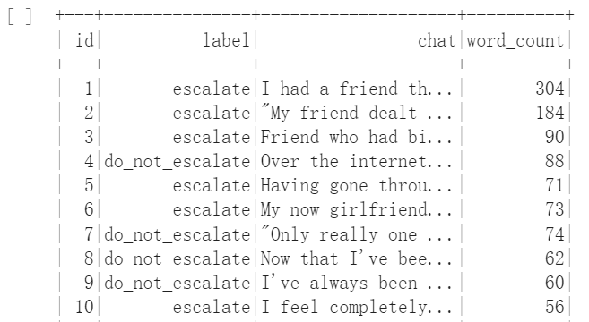
Create word_count Column (Cont’d)
The newly created column (word_count) is shown below.
Notes:
A new column, word_count, is created to calculate how many words are used in each of the 100 transactions between the chatbot and the online visitor. The newly created column, word_count, can be seen in the following screenshot:

Slide 20
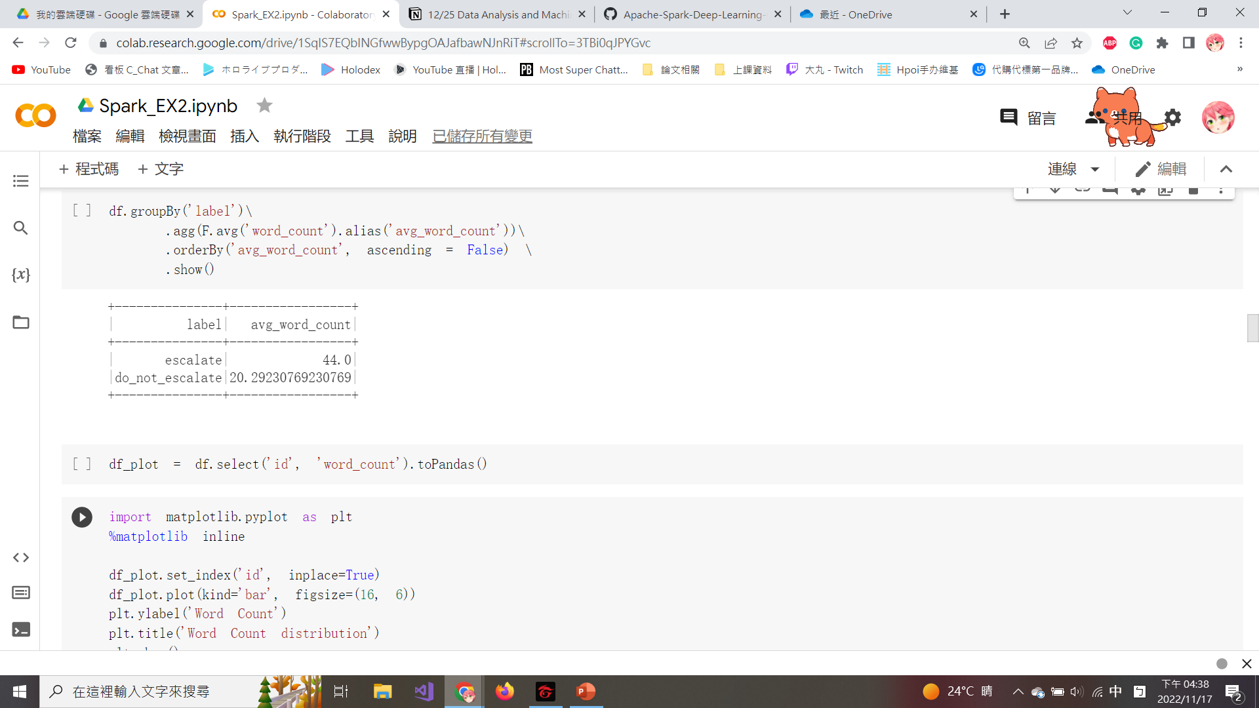
Calculate the Average Word Count
Dataframe can be aggregated by agg() to calculate the average word count by label column.
alias(): Give the second name to a piece of data.
Notes:
Aggregate the average word count by label column using the following script:
Dataframe can be aggregated by agg() to calculate the average word count by label column.
alias(): Give the second name to a piece of data.
Since the word_count is now added to the dataframe,, we can see that escalate conversations on average are more than twice as long as do_not_escalate conversations.
使用以下程式按標籤列匯總平均字數：
Dataframe 可以通過 agg() 聚合以計算標籤列的平均字數。
alias()：給一段數據取第二個名字。
由於 word_count 現在已添加到數據框中，我們可以看到升級對話的平均長度是 do_not_escalate 對話的兩倍多。

Slide 21
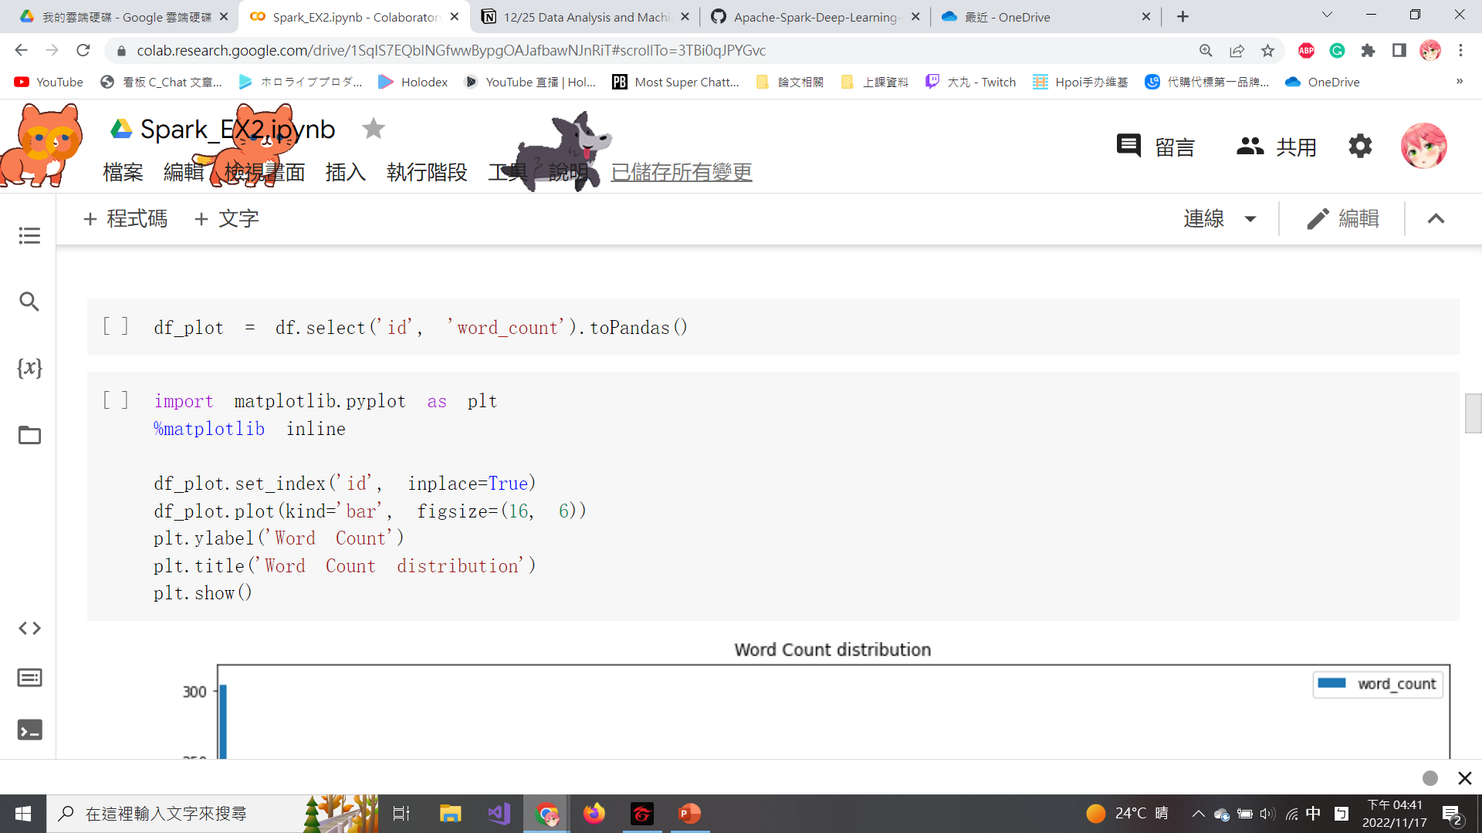
Import matplotlib
Convert Spark dataframe into a pandas dataframe by using toPandas().
Importing matplotlib for plotting.
Notes:
Convert Spark dataframe to a pandas dataframe by using toPandas().
importing matplotlib for plotting.
因為我們需要將資料進行視覺化，因此使用 toPandas() 將 Spark 數據幀轉換為 pandas 數據幀。
導入 matplotlib 進行繪圖。

Slide 22
Draw the Bar Chart
set_index(): Set the dataframe index to ‘id’ and when the set ‘inplace = True’, the reset_index method will directly modify and overwrite the original dataframe.
plot(): Assign the figure to bar chart and set the figure size.
title(): Set the title of the figure.
Set the y-values to be word_count by ylabel().
Notes:
Next, we are going to Draw the Bar Chart of word count. You can Plot the dataframe using the following script:
set_index(): Set the dataframe index to ‘id’ and when the set ‘inplace = True’, the reset_index method will directly modify and overwrite the original dataframe.
plot(): Assign the figure to bar chart and set the figure size.
title(): Set the title of the figure.
Set the y-values to be word_count by ylabel().
接下來，我們將繪製字數統計條形圖。 您可以使用以下腳本繪製數據框：
set_index()：設置dataframe索引為‘id’，當設置‘inplace = True’時，reset_index方法會直接修改並覆蓋原來的dataframe。
plot()：將圖形分配給條形圖並設置圖形大小。
title()：設置圖形的標題。
通過 ylabel() 將 y 值設置為 word_count。

Slide 23
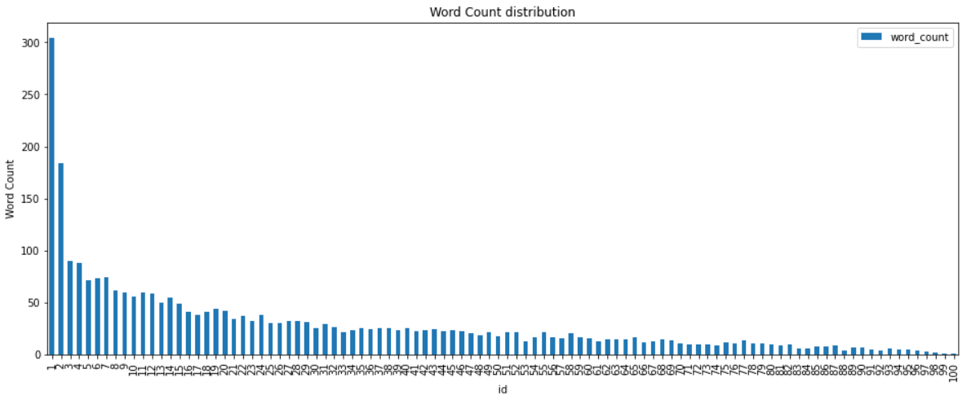
Draw the Bar Chart (Cont’d)
The bar chat is shown below.
Notes:
That subset of data is then plotted using matplotlib setting the y-values to be word_count and the xvalues to be the id as seen in the following screenshot:
然後使用 matplotlib 繪製該數據子集，將 y 值設置為 word_count，將 x 值設置為 id，如以下屏幕截圖所示

Slide 24
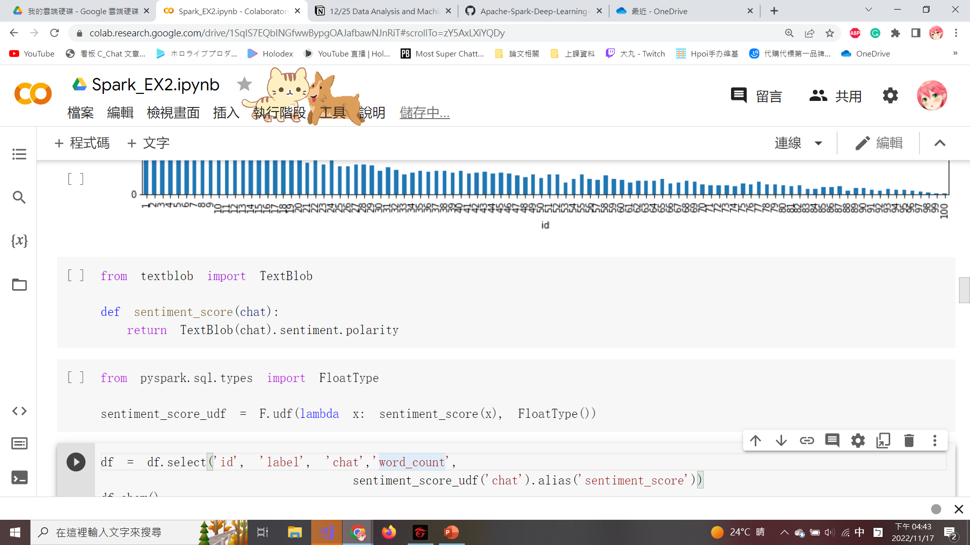
Import Textblob
Textblob is a sentiment analysis library in Python that can calculate the sentiment score.
sentiment.polarity: Calculate scores from -1 (very negative) to +1 (very positive), and 0 means neutral.
sentiment_score() is defined to generate the sentiment polarity of each conversation in a new column.
Notes:
Next, we need to Create a sentiment score function, using the following script:
Textblob is a sentiment analysis library in Python that can calculate the sentiment score.
sentiment.polarity: Calculate scores from -1 (very negative) to +1 (very positive), and 0 means neutral.
sentiment_score() is defined to generate the sentiment polarity of each conversation in a new column.
接下來，為了要評量每筆資料是否具有正面或負面的語氣，我們需要使用Textblob創建情緒評分函數：
Textblob是Python中的一個情感分析庫，可以計算情感分數。
sentiment.polarity：計算從-1（非常消極）到+1（非常積極）的分數，0表示中立。
sentiment_score() 被定義為在新列中生成每個對話的情緒極性。

Slide 25
User-defined Function
Create a user-defined function (udf) in PySpark SQL.
Create a lambda function, called sentiment_score_udf that maps sentiment_score into a udf() to each transaction and specifies the output type to FloatType.
Notes:
Apply sentiment_score to each conversation response in the dataframe.
Create a user-defined function (udf) in PySpark SQL.
Create a lambda function, called sentiment_score_udf, that maps sentiment_score into a user-defined function within Spark, and specifies the output type to FloatType as seen in the following script
1. 導入 Textblob，並將名為 sentiment_score 的函數應用於”chat’列，以在新列中生成每筆對話的情緒分數，也稱為 sentiment_score。
2. 如果不首先在 Spark 中通過自定義的函數轉換 udf，則不能將 Python 函數直接應用於 Spark 數據框。
3. 此外，還必須明確說明函數的輸出，無論是整數還是浮點數據類型。 在我們的情況下，我們明確聲明函數的輸出將使用 pyspark.sql.types 中的 FloatType()。 最後，使用 udf 情緒評分函數中的 lambda 函數（稱為 sentiment_score_udf）將情緒應用於每一行。

Slide 26
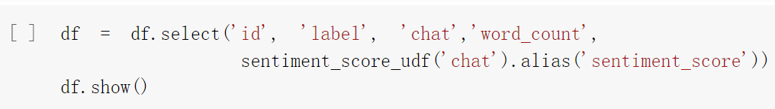
Calculate the sentiment_score
Apply the sentiment_score_udf() to each ‘chat’ column in the dataframe to calculate sentiment_score.
The updated dataframe with the newly created field (sentiment_score) can be seen by executing df.show().
Notes:
Apply the sentiment_score_udf() to each ‘chat’ column in the dataframe to calculate sentiment_score.
The updated dataframe with the newly created field (sentiment_score) can be seen by executing df.show().
1. 導入 Textblob，並將名為 sentiment_score 的函數應用於”chat’列，以在新列中生成每筆對話的情緒分數，也稱為 sentiment_score。
2. 如果不首先在 Spark 中通過自定義的函數轉換 udf，則不能將 Python 函數直接應用於 Spark 數據框。
3. 此外，還必須明確說明函數的輸出，無論是整數還是浮點數據類型。 在我們的情況下，我們明確聲明函數的輸出將使用 pyspark.sql.types 中的 FloatType()。 最後，使用 udf 情緒評分函數中的 lambda 函數（稱為 sentiment_score_udf）將情緒應用於每一行。
通過執行 df.show() 可以看到具有新創建字段的更新數據框，如以下屏幕截圖所示：

Slide 27
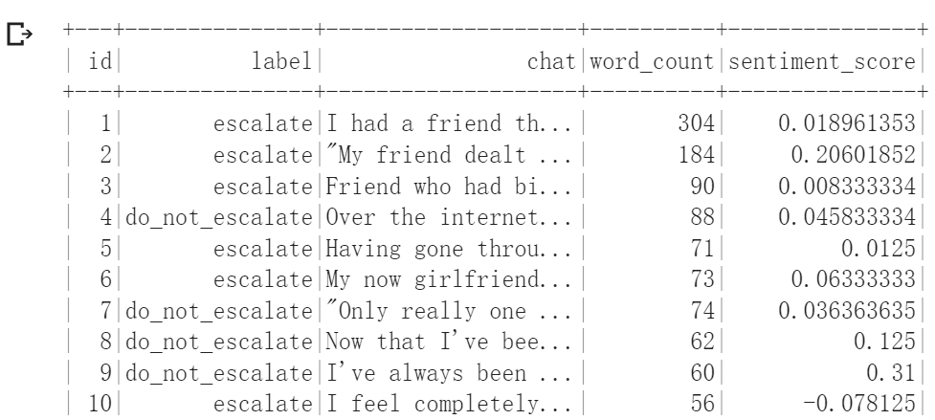
Calculate the sentiment_score (Cont’d)
The updated dataframe with sentiment_score is shown below.

Slide 28
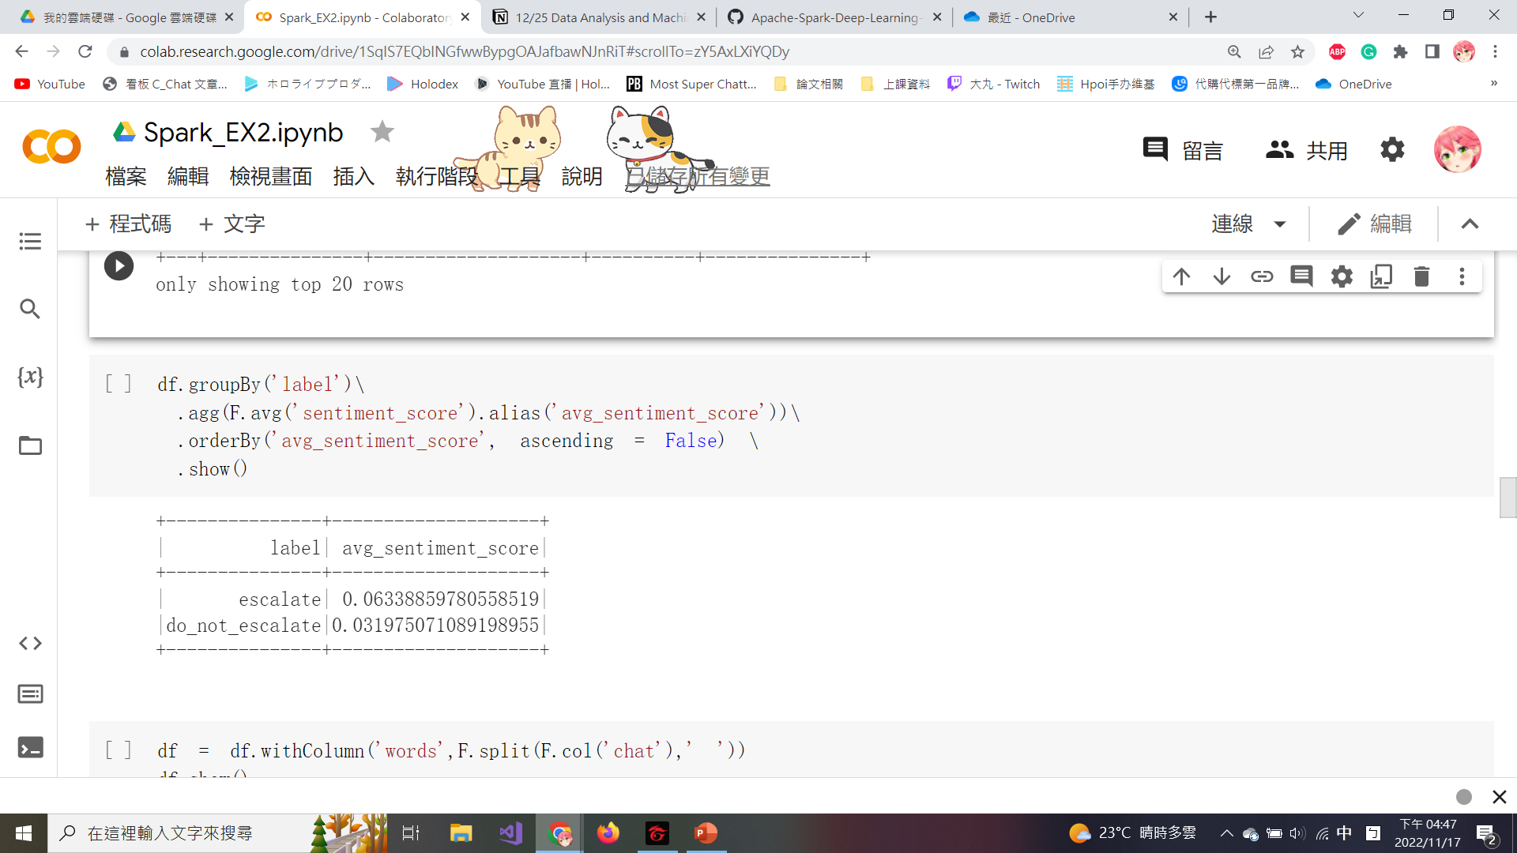
Calculate the Average Sentiment Score
Compare whether escalate conversations in the label are more positive or negative by calculating an avg_sentiment_score.
Notes:
Calculate the average sentiment score by label column by using the following script:
Now that the sentiment_score is calculated for each response from the chat conversation, we can denote a value range of -1 (very negative polarity) to +1 (very positive polarity) for each row.
We can compare whether escalate conversations in the label are more positive or negative by calculating an avg_sentiment_score.
使用以下腳本按標籤列計算平均情緒分數：
現在 sentiment_score 是為聊天對話中的每個響應計算的，我們可以為每一行表示 -1（非常消極的極性）到 +1（非常積極的極性）的值範圍。
我們可以通過計算 avg_sentiment_score 來比較標籤中escalate對話在情緒分數上比 do_not_escalate 對話更積極還是消極。
我们实际上发现，escalate对话的极性比do_not_escalate对话的极性略微積極；但是，两者都很中性，因为它们都接近于0。
這兩種資料結果都接近於0，表示sentiment_score() 判斷這兩種類型的”chat”資料，在情感分析上都是接近於中性，於是我們需要解決這種現象，最好的解決方法之後會介紹，就是藉由remove stop word的方式來達成

Slide 29
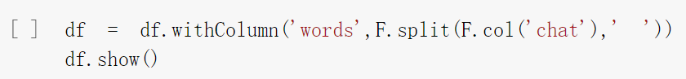
Convert each Word in ‘chat’ Column into a String
Execute the following script to convert each word in ‘chat’ column into a string within an array.
Notes:
Next, we Convert each Word in ‘chat’ Column into a String.
Execute the following script to convert each word in ‘chat’ column into a string within an array.
所以為了讓預測更準確我們需要進行一些資料處理，自進行處理之前我們先要將“chat”列中的每個單詞轉換為字串
執行以下腳本將“chat”列中的每個單詞轉換為array中的字串。

Slide 30
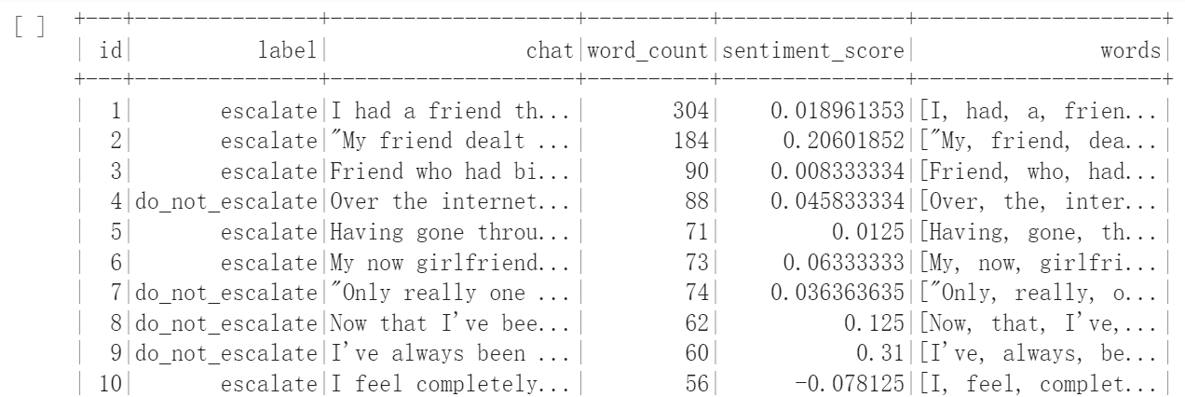
Convert each Word in ‘chat’ Column into a String (Cont’d)
The newly created column (words) is shown below.
Notes:
You can see that the word in ‘chat’ column are converted into a string within an array.

Slide 31
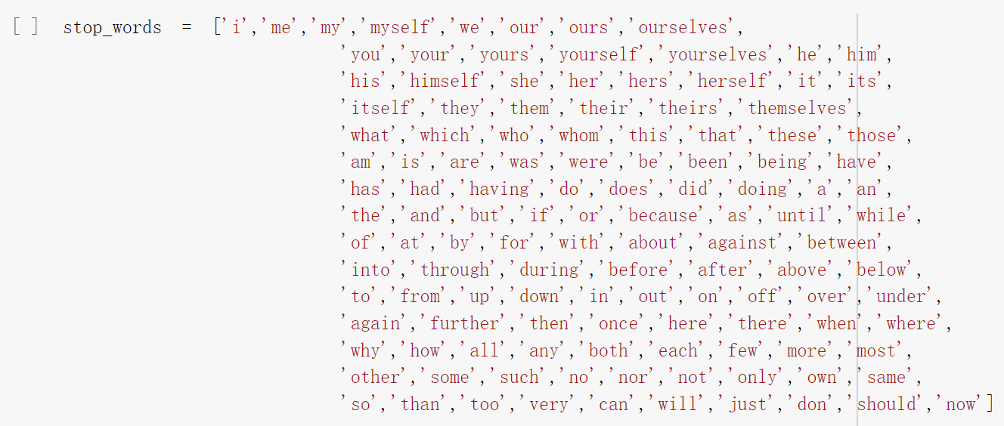
Stop Word in NLP
A stop word is a very common word used in the English and is often removed from common NLP techniques.
You can copy stop_word from the memo on this page.
Notes:
Next, we need to remove the stop word.
And What is stop word. A stop word is a very common word used in the English and is often removed from common NLP techniques.
Assign a list of common words to a variable, stop_words, that will be considered stop words to remove by using the following script:
接下來，我們需要刪除停用詞(stop word)。
什麼是停用詞。 停用詞是英語中非常常用的詞，通常從常見的 NLP 技術中刪除。
將常用詞列表分配給變量 stop_words，這些詞將被視為要使用以下腳本刪除的停用詞：

Slide 32
Copy the Stop Word
stop_words = ['i','me','my','myself','we','our','ours','ourselves',
'you','your','yours','yourself','yourselves','he','him',
'his','himself','she','her','hers','herself','it','its',
'itself','they','them','their','theirs','themselves',
'what','which','who','whom','this','that','these','those',
'am','is','are','was','were','be','been','being','have',
'has','had','having','do','does','did','doing','a','an',
'the','and','but','if','or','because','as','until','while',
'of','at','by','for','with','about','against','between',
'into','through','during','before','after','above','below',
'to','from','up','down','in','out','on','off','over','under',
'again','further','then','once','here','there','when','where',
'why','how','all','any','both','each','few','more','most',
'other','some','such','no','nor','not','only','own','same',
'so','than','too','very','can','will','just','don','should','now']

Slide 33
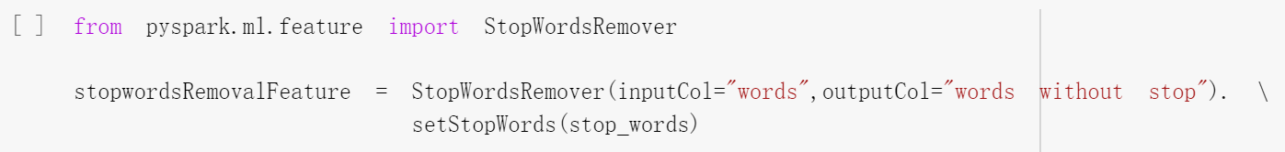
Remove the Stop Words
Import the StopWordsRemover function from PySpark to filter out columns by setting the inputCols parameter.
The newly created column is specified outputCol="words without stop“.
setStopWords(): Set the value of stop words.
Notes:
Execute the following script to import the StopWordsRemover function from PySpark and configure the input and output columns to remove stop words:
Import the StopWordsRemover function to filter out columns by setting the inputCols parameter.
The newly created column is specified outputCol="words without stop“.
setStopWords(): Set the value of stop words.
執行以下腳本從 PySpark 導入 StopWordsRemover 函數並配置輸入和輸出列以刪除停用詞：
導入 StopWordsRemover 函數，通過設置 inputCols 參數過濾列。
新創建的列指定為 outputCol="words without stop“。
setStopWords()：設置停用詞的值。

Slide 34
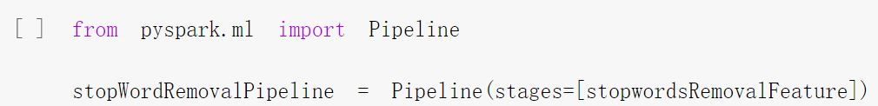
Remove the Stop Words (Cont’d)
Import Pipeline and define the stages as stopwordRemovalFeature to transform the dataframe.
MLlib consists of a sequence of Pipeline stages (estimator and transformer) to be run in a specific order.
Notes:
Execute the following script to import Pipeline and define the stages for the stop word transformation process that will be applied to the dataframe
Import Pipeline and define the stages as stopwordRemovalFeature to transform the dataframe.
MLlib consists of a sequence of Pipeline stages (estimator and transformer stage) to be run in a specific order.
為了移除stop word，執行以下程式以導入Pipeline以快速的移除大量stop word，並將stage設為StopWordsRemovalFeature。
導入 Pipeline 並將階段定義為 stopwordRemovalFeature 以轉換數據框。MLlib 由一系列以特定順序運行的Pipeline階段（估計器和轉換器階段）組成。
#Fits a model to the input dataset with optional parameters. When Pipeline.fit() is called, the stages are executed in order.
#We create a pipeline, stopWordRemovalPipeline, to define the sequence of steps or stages that will transform the data. In this situation, the only stage that will be used to transform the data is the feature, stopwordsRemover.
#import Pipeline and define the stages for the stop word transformation process that will be applied to the dataframe

Slide 35
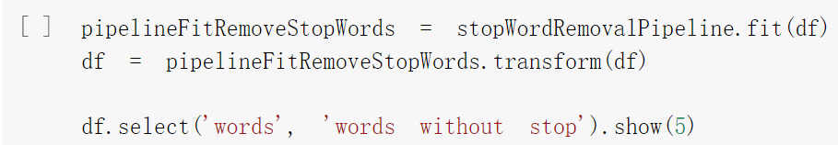
Remove the Stop Words (Cont’d)
Estimator stage: The fit() is called to produce a transformer.
Transformer stage: The transform() is called on the dataframe for stop word removal transformation.
Notes:
估算器階段：調用 fit() 來生成轉換器。简单来说，就是求得训练集的均值啊，方差啊，最大值啊，最小值啊这些固有的属性。可以理解为一个训练过程
轉換器階段：在數據幀上調用 transform() 以進行停用詞刪除轉換。在Fit的基础上，进行标准化等操作

Slide 36
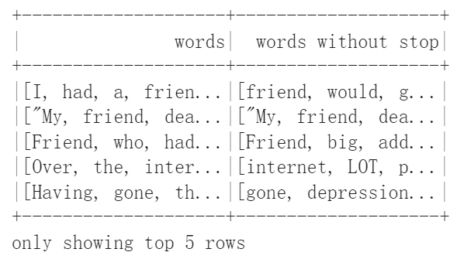
Remove the Stop Words (Cont’d)
The dataframe with a new column called words without stop is shown below.
Notes:
The new column, words without stop, contains none of the strings that are considered stop words from the original column, words.

Slide 37
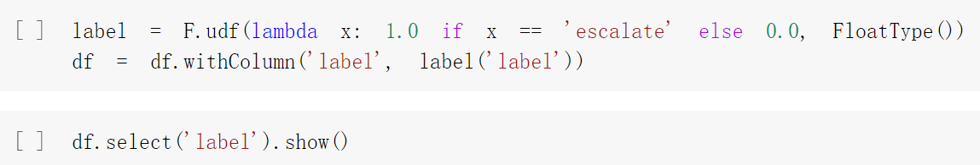
Classify the Label and Assign Values
If the data in the label column is ‘escalate’ the numerical values will assign to 1, otherwise assign to 0.
All labels under the label column are converted to a numerical label of 0.0 or 1.0 with FloatType().
Notes:
Next, we will train the TF-IDF model.
First, Create a new user-defined function, udf, to define numerical values for the label column using the following script:
If the data in the label column is ‘escalate’ the numerical values will assign to 1, otherwise assign to 0.
All labels under the label column are converted to a numerical label of 0.0 or 1.0 with FloatType().
接下來，我們將訓練 TF-IDF 模型。
首先，創建一個新的用戶定義函數 udf，使用以下腳本為標籤列定義數值：
如果標籤列中的數據為“escalate”，則數值將分配給 1，否則分配給 0。
使用 FloatType() 將標籤列下的所有標籤轉換為 0.0 或 1.0 的數字標籤。

Slide 38
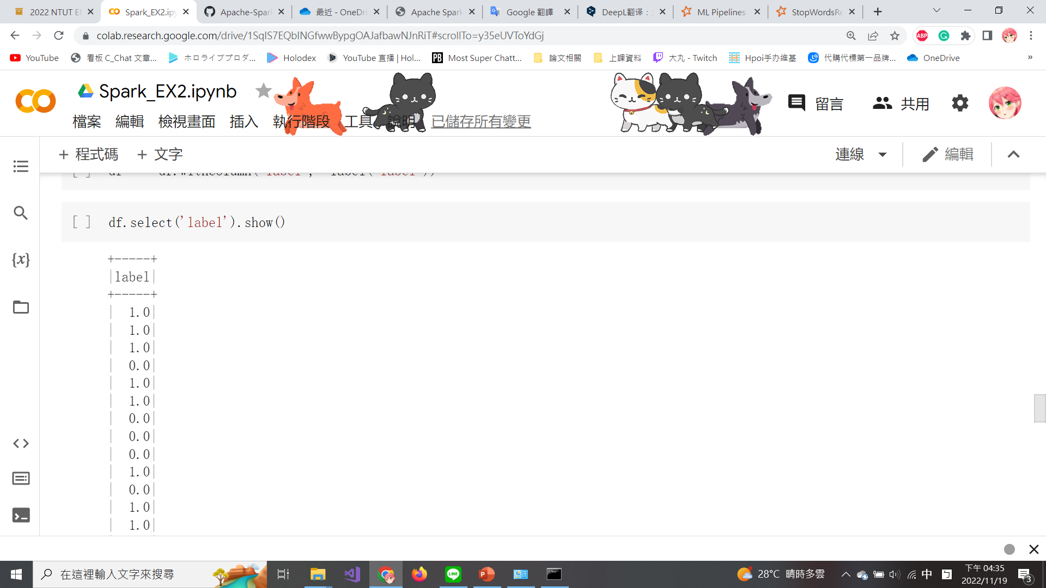
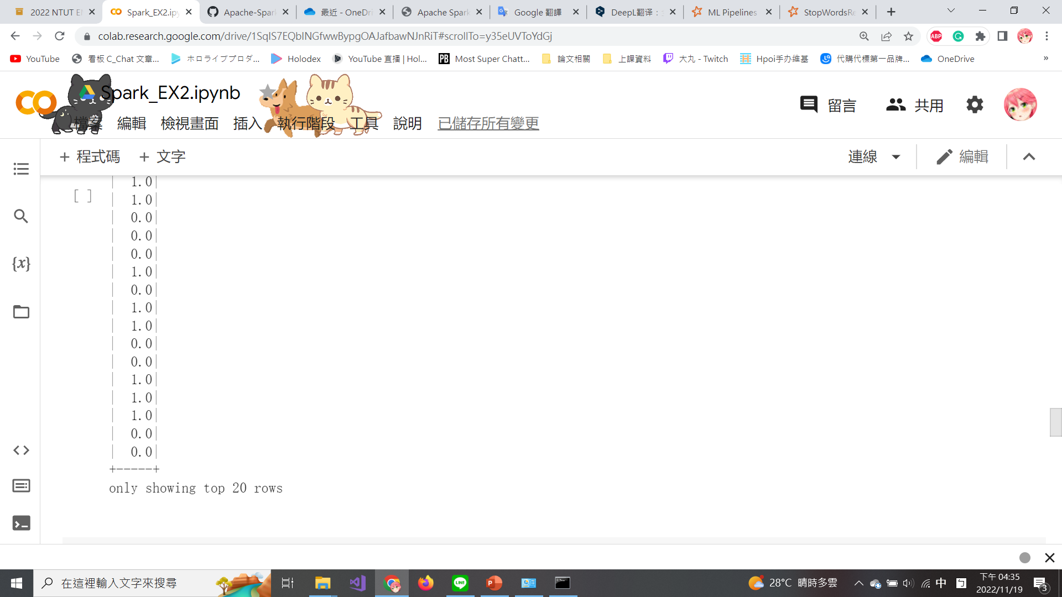
Classify the Label and Assign Values (Cont’d)
The label column is converted to a numerical label of 0.0 or 1.0 as shown in the figure.

Slide 39
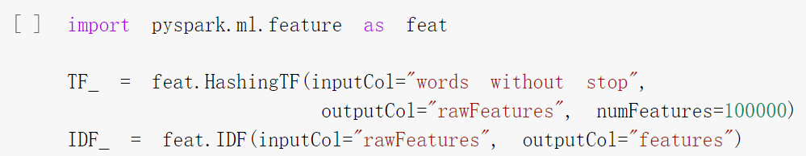
TF-IDF
Term frequency-inverse document frequency (TF-IDF) is a feature vectorization method widely used in text mining to reflect the importance of a term to a document in the corpus.
TF-IDF models require a two-step approach by importing both HashingTF() and IDF() from pyspark.ml.feature.
The numFeatures parameter is set to 100,000 to ensure that it is larger than the distinct number of words in the dataframe.
Notes:
Next, set the TF and IDF columns for the vectorization of the words
Term frequency-inverse document frequency (TF-IDF) is a feature vectorization method widely used in text mining to reflect the importance of a term to a document in the corpus.
TF-IDF models require a two-step approach by importing both HashingTF() and IDF() from pyspark.ml.feature.
The numFeatures parameter is set to 100,000 to ensure that it is larger than the distinct number of words in the dataframe.
Execute the following script to set the TF and IDF columns for the vectorization of the words:
接下來，為單詞的向量化設置TF和IDF列
詞頻-逆文檔頻率（TF-IDF）是一種廣泛應用於文本挖掘中的特徵向量化方法，用於反映詞條對語料庫中文檔的重要性。
TF-IDF 模型需要一個兩步驟方法，即從 pyspark.ml.feature 導入 HashingTF() 和 IDF()。
numFeatures 參數設置為 100,000，以確保它大於數據幀中不同的單詞數。
執行以下腳本來設置單詞向量化的 TF 和 IDF 列：
Pyspark.ml.feature: 給定閾值，對一列連續特徵進行二值化。

Slide 40
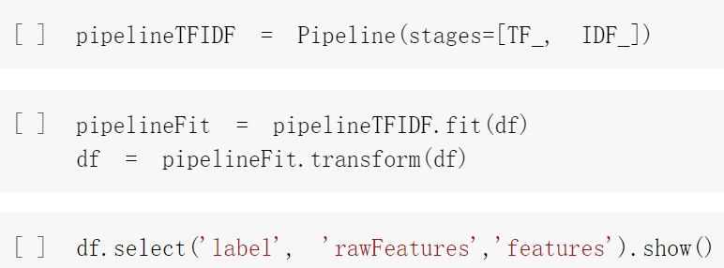
TF-IDF (Cont’d)
Define the stages as [TF_, IDF_] to order the sequence of steps where IDF will follow HashingTF.
The HashingTF class can count the number of times each word appears in a document and save it as a vector.
The more a word appears in certain documents, the larger the IDF is, and the more important it is to the entire corpus. vice versa.
Notes:
Set up a pipeline, pipelineTFIDF, to set the sequence of stages for TF_ and IDF_ using the following script
HashingTF will transform the words without stop into vectors within a new column called rawFeatures.
rawFeatures will next be consumed by IDF to estimate the size and fit the dataframe to produce a new column called features.
The HashingTF class can count the number of times each word appears in a document and save it as a vector.
The more a word appears in certain documents, the larger the IDF is, and the more important it is to the entire corpus. vice versa.
使用以下腳本設置管道 pipelineTFIDF 以設置 TF_ 和 IDF_ 的階段順序
HashingTF 會將words without stop轉換為名為 rawFeatures 的新列中的向量。 IDF 接下來將使用 rawFeatures 來估計大小並擬合數據框以生成一個名為 features 的新列。
HashingTF类可以统计各个单词(term)在一篇文档中出现的次数(term frequence,TF)，并以向量的方式保存
IDF (逆向文件頻率) 有許多單詞，其詞頻非常高，卻不具重要性，如 a/an、 the 等停用詞。某個單詞愈是集中出現在某幾份文件中，則 idf 就愈大，其之於整個語料庫而言就愈重要。反之亦然

Slide 41
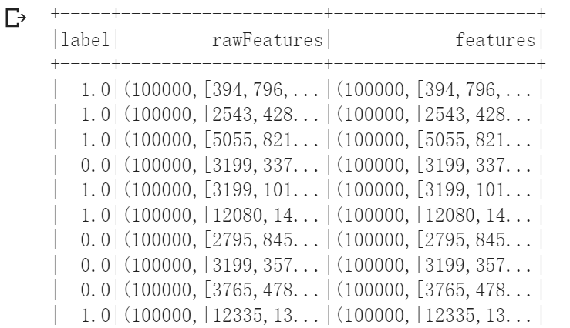
TF-IDF (Cont’d)
The 2 new columns are shown below.
Notes:
The 2 new columns rawFeatures and features are shown below.

Slide 42
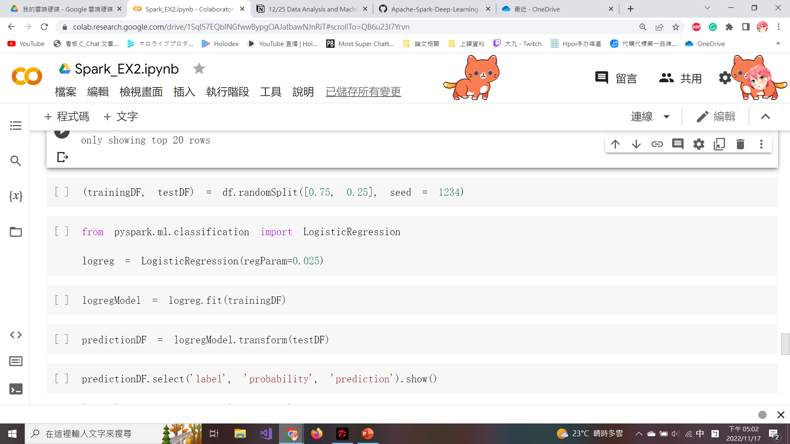
Logistic Regression Model
For training purposes, the dataframe will be split as 75:25 with a random seed set at 1234.
Use a traditional classification algorithm such as a logistic regression model from PySpark.
The logistic regression model is configured with a regularization parameter, regParam as 0.025.
Notes:
For training purposes, the dataframe will be split into a 75:25 ratio with a random seed set at 1234.
Use a traditional classification algorithm such as a logistic regression model from PySpark.
The logistic regression model is configured with a regularization parameter, regParam as 0.025.
由於我們的主要目標是將每個對話分類為escalate、do_not_escalate。出於訓練目的，數據幀將按 75:25 的比例拆分，隨機種子設置為 1234。
我們可以使用傳統的分類算法，例如 PySpark 庫中的邏輯回歸模型。
邏輯回歸模型配置了 0.025 的正則化參數 regParam。 我們使用該參數通過最小化過度擬合來略微改進模型，但會犧牲一點偏差。

Slide 43
Logistic Regression Model (Cont’d)
The logistic regression model (logregModel) is trained and fitted on trainingDF.
predictionDF is created based on the transform() from the logistic regression model.
Notes:
We have to know the probability and prediction through the logistic regression model, by executing the following scrip:
The logistic regression model (logregModel) is trained and fitted on trainingDF.
predictionDF is created based on the transform() from the logistic regression model.
通過執行以下程式碼，我們可以通過邏輯回歸模型了解經計算過後的escalte以及do-not-escalate的預測概率和預測結果是否正確：
邏輯回歸模型 (logregModel) 在 trainingDF 上進行訓練和擬合。
predictionDF 是基於邏輯回歸模型的 transform() 創建的。

Slide 44
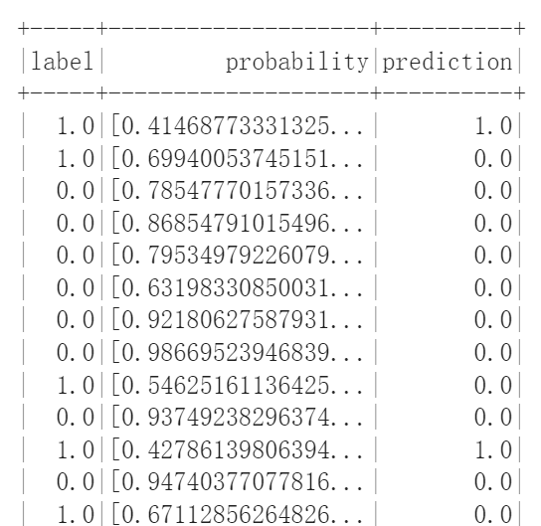
Logistic Regression Model (Cont’d)
The probability and prediction are shown in the figure.

Slide 45
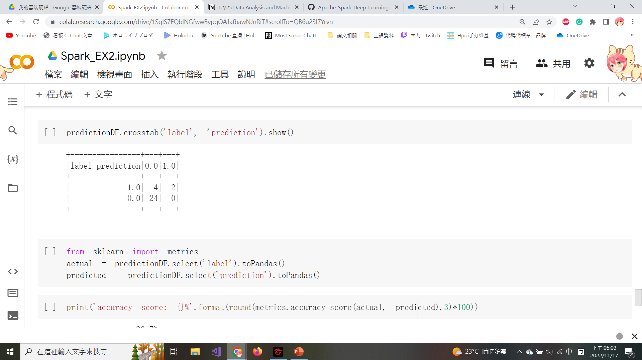
Create Confusion Matrix
crosstab(): Compute a simple cross-tabulation of 2 (or more) factors.
A confusion matrix is helpful to quickly summarize the accuracy numbers between actual results and predicted results.
Notes:
Create a confusion matrix to summarize the accuracy numbers between actual results and predicted results in the following script:
crosstab(): Compute a simple cross-tabulation of 2 (or more) factors.
在以下腳本中創建一個混淆矩陣來總結實際結果和預測結果之間的準確度數字：
crosstab()：計算 2 個（或更多）因子的簡單交叉表。

Slide 46
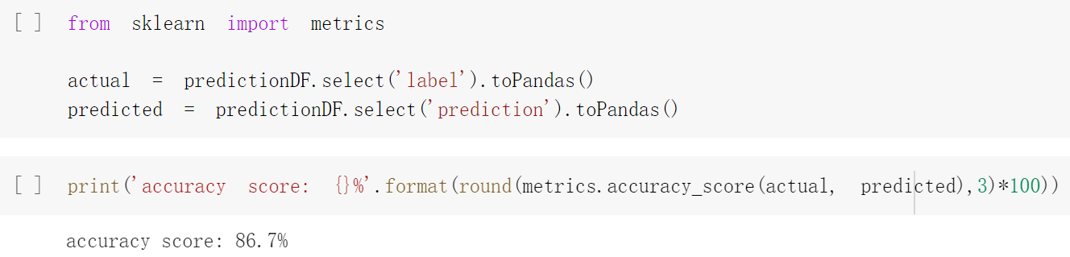
Compute the Prediction Accuracy
The sklearn.metrics module implements several loss, score, and utility functions to measure probability estimates of the positive class.
The “actual” values are tied to the label column.
The “predicted” values are tied to the prediction column.
metrics.accuracy_score(): Compute subset accuracy.
Notes:
Evaluate the model using metrics from sklearn with the following script:
The sklearn.metrics module implements several loss, score, and utility functions to measure probability estimates of the positive class.
The “actual” values are tied to the label column.
The “predicted” values are tied to the prediction column.
accuracy_score(): Compute subset accuracy.
Two variables are created, actual and predicted, and an accuracy score of 86.7% is calculated using the metrics.accuracy_score() function, as seen in the following screenshot:
使用以下腳本使用來自 sklearn 的指標評估模型：
sklearn.metrics 模塊實現了幾個損失函數、分數函數和效用函數來測量模型的positive的機率(是否準確)。
“實際”值與標籤列相關聯。
“預測”值與預測列相關聯。
accuracy_score()：計算子集的準確性。
創建了兩個變量，實際變量和預測變量，並使用 metrics.accuracy_score() 函數計算出 86.7% 的準確度分數，如以下屏幕截圖所示：

Slide 47
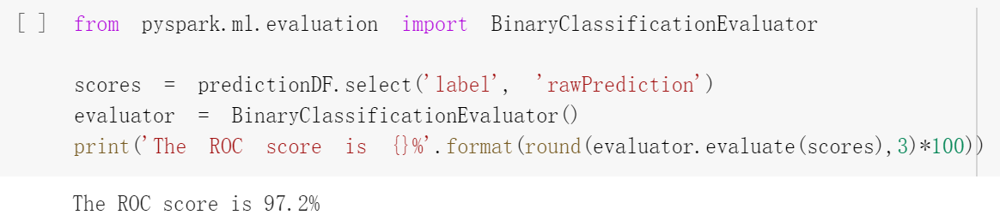
Compute ROC Score
The ROC (Receiver Operating Characteristic) is often associated with measuring the performance of the model.
Import the BinaryClassificationEvaluator function to calculate the ROC.
evaluate(): Evaluate the output with optional parameters.
Notes:
Calculate the ROC score using the following script:
The ROC (Receiver Operating Characteristic) is often associated with measuring the performance of the model.
Import the BinaryClassificationEvaluator function to calculate the ROC.
evaluate(): Evaluate the output with optional parameters.
使用以下腳本計算 ROC 分數：
ROC（接受者操作特徵）通常與衡量模型的性能與可靠性有關。
導入 BinaryClassificationEvaluator 函數來計算 ROC。
evaluate()：使用可選參數評估輸出。

Slide 48
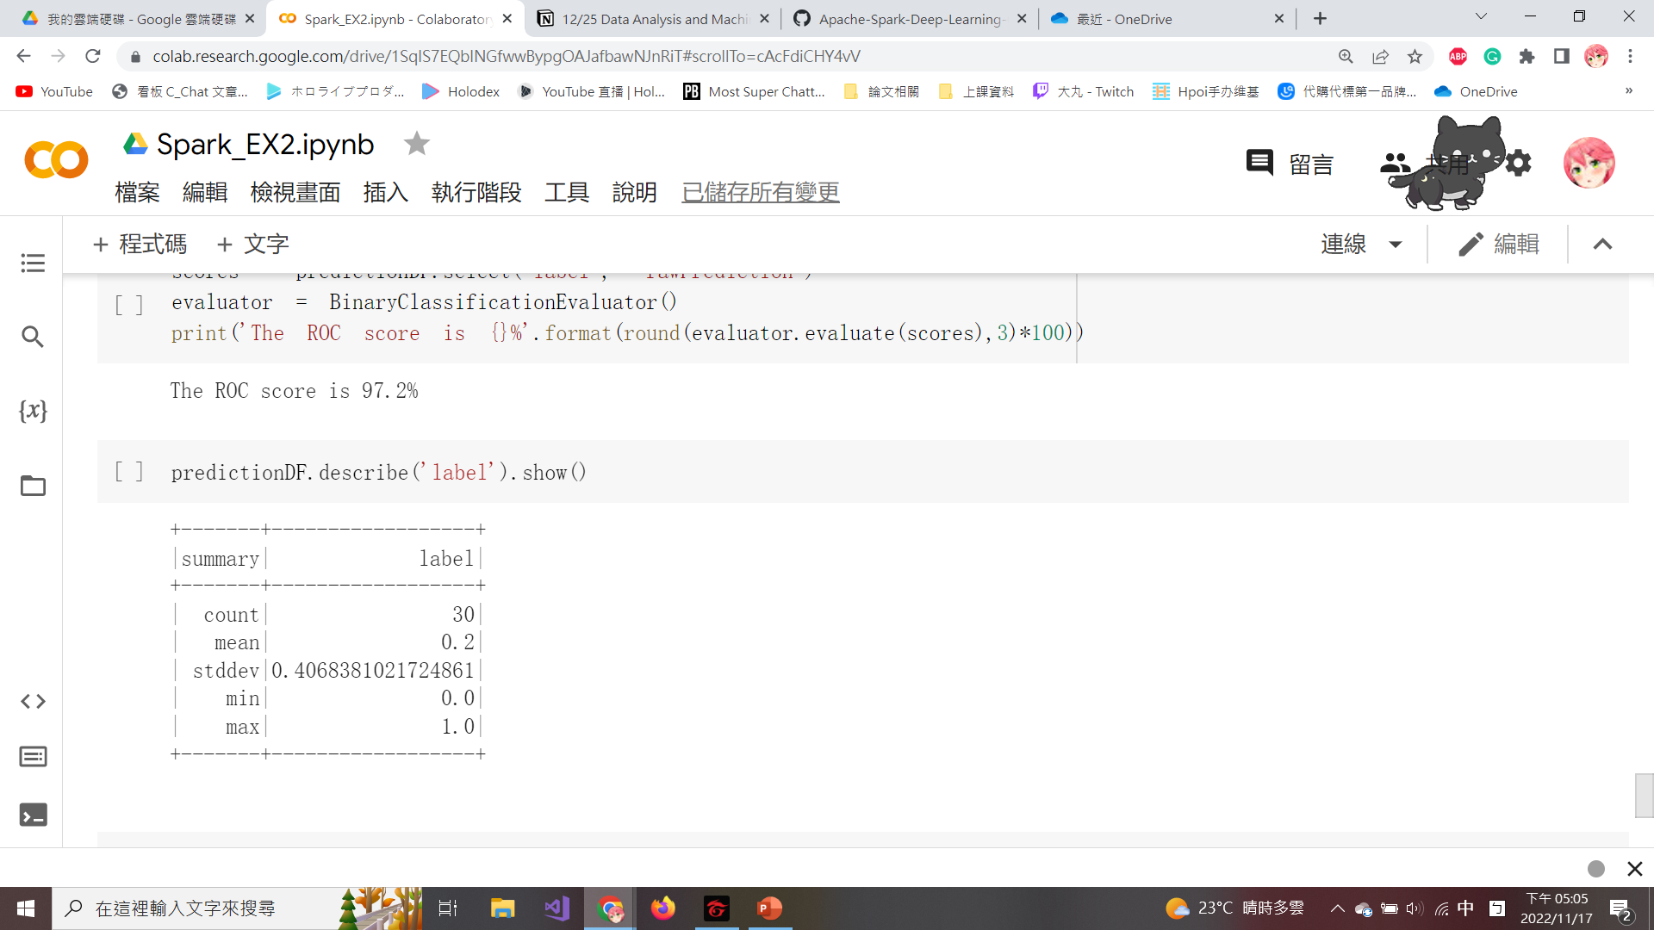
Evaluation Results and Conclusions
describe(): View some basic statistical details such as percentiles, mean, standard deviation, etc.
If we labeled each conversation as do_not_escalate, we would be correct ~80% of the time, which is less than our model accuracy of 86.7%.
Our model performs better than a blind baseline performance model.
Notes:
Finally, we Execute the following script to retrieve the mean value from to realize Is our model more reliable than a blinded baseline performance model:
describe(): View some basic statistical details such as percentiles, mean, standard deviation, etc.
The mean of label is at 20%, which means that a label of one occurs only 20% of the time.
If we labeled each conversation as do_not_escalate, we would be correct ~80% of the time, which is less than our model accuracy of 86.7%.
we can say that our model performs better than a blind baseline performance model.
describe()：查看一些基本的統計細節，如百分位數、均值、標準差等。
label的平均值為 20%，這意味著label為 1 的概率僅為 20%。 因此，如果我們將每個對話標記為 do_not_escalate，我們將在大約 80% 的時間內是正確的，這低於我們 86.7% 的模型準確率。
因此，我們可以說我們的模型比盲基線性能模型表現更好。

Slide 49
Predicting Apple’s Stock Price by Using Keras
Notes:
Now we are going to introduce you how to predicte the Apple stock price by using Keras.
And what is Keras? Keras is based on minimal structure that provides a clean and easy way to create deep learning models based on TensorFlow.
Keras is designed to quickly define deep learning models. Well, Keras is an optimal choice for deep learning applications.
現在我們將向您介紹如何使用 Keras 預測蘋果股票價格。
什麼是 Keras？ Keras 基於最小化結構，提供了一種干淨、簡單的方法來創建基於 TensorFlow 的深度學習模型。
Keras 旨在快速定義深度學習模型。 那麼，Keras 是深度學習應用的最佳選擇。

Slide 50
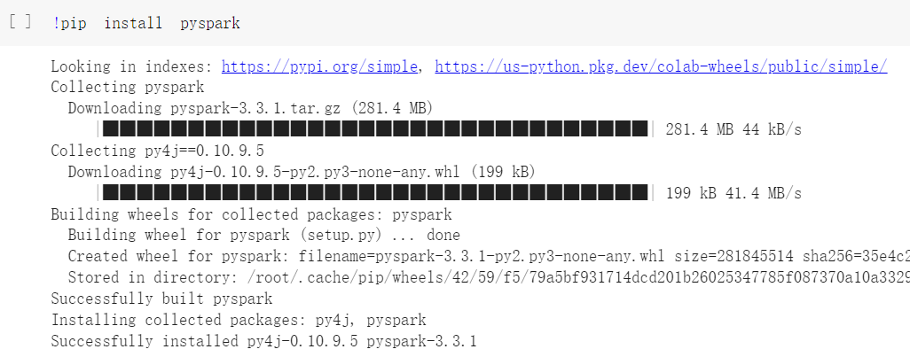
Install Pyspark
Create a new file in Google Colab and install pyspark with !pip install pyspark.
Notes:
在 Google Colab 中創建一個新文件並使用 !pip install pyspark 安裝 pyspark。

Slide 51
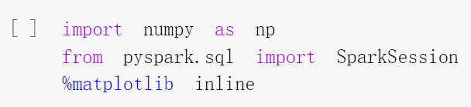
Import the Libraries
Numpy is a basic function library required for scientific operations using Python, including array operations.
You can invoke the Numpy functions with np.
Load Numpy with import numpy as np.
Notes:
Next, we need to import the needed libraries.
Numpy is a basic function library required for scientific operations using Python, including array operations.
You can invoke the Numpy functions with np.
Load Numpy with import numpy as np.
Numpy 是使用 Python 進行科學運算（包括數組運算）所需的基礎函數庫。
您可以使用 np.numpy 調用 Numpy 函數。
使用 import numpy as np.load Numpy 加載 Numpy。

Slide 52
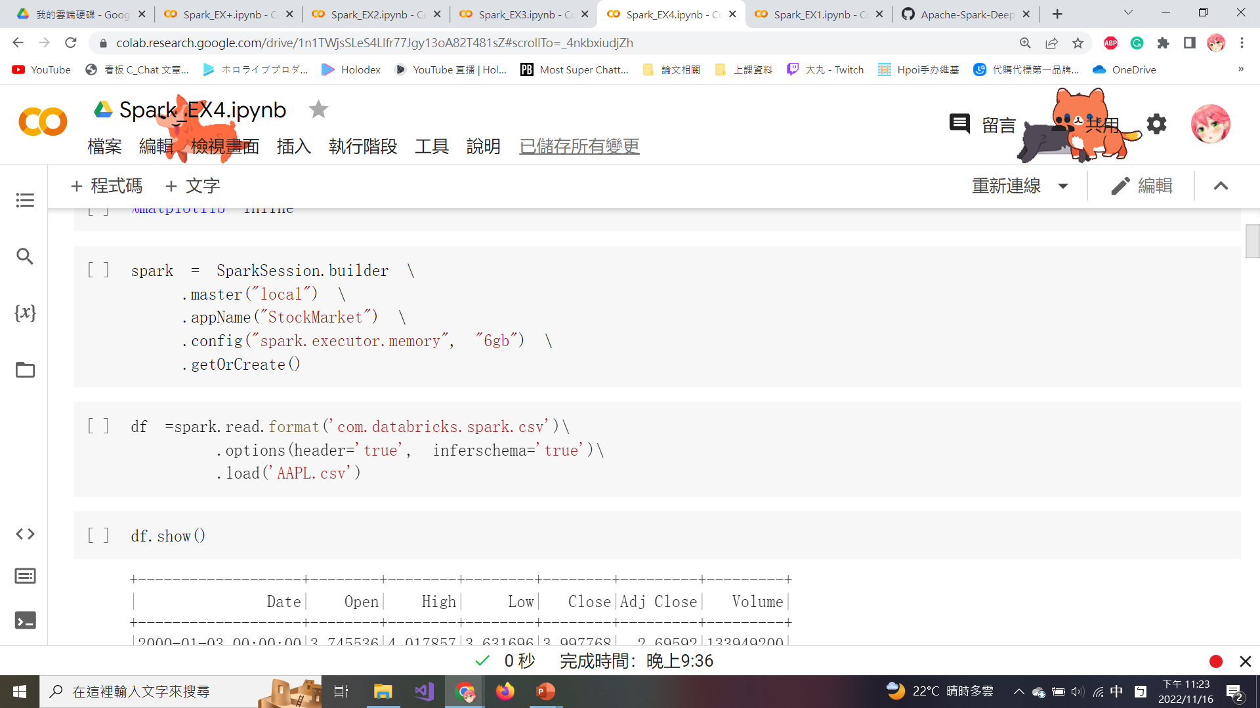
SparkSession
master(“local”): Set the Spark master URL to connect to, and “local” means to run locally.
appName(): Set the app name to “StockMarket”.
Config(): Configure 6 GB of space for spark.executor.memory.
getOrCreate(): Get an existing SparkSession or creates a new one based on the options set in the builder.
Notes:
Configure SparkSession with a variable named spark using the following script:
The only difference from the previous one is the naming of SparkSession. the app name is set to “StockMarket”.
使用以下程式碼，定義名為 spark 的變量，並為其配置 SparkSession：
與上一個唯一不同的是 SparkSession 的命名。 應用程序名稱設置為“StockMarket”。

Slide 53
Create the Dataframe
Dataframe is created by reading the file “AAPL.csv”.
option(header=‘true’): Treat the first line of the CSV file as field names.
option(inferschema=‘true’): Spark will automatically go through the CSV file and infer the schema of each column.
Notes:
Next, we assign the dataset to a dataframe in Spark, called df.
The contents of the dataset can be seen by clicking on AAPL.csv on the repository as seen in the following screenshot:
接下來，我們將讀取CSV檔案中的數據，並分配給 Spark (中的數據框架)，稱為 df
數據框是通過讀取文件“AAPL.csv”創建的。

Slide 54
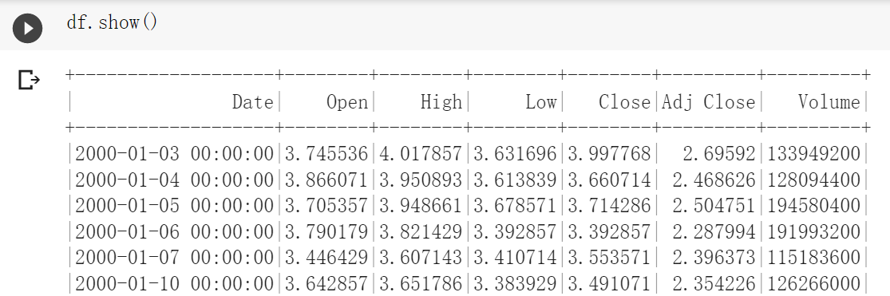
Create the Dataframe (Cont’d)
A part of dataframe is shown below.
Notes:
The dataframe can be viewed by executing df.show(), as seen in the following figure.
The dataframe will allow us to view the Date, Open, High, Low, Close, Adj Close, and Volume of the stock on a daily basis.
可以通過執行 df.show() 查看數據幀，如下圖所示。
數據框將允許我們每天查看股票的日期、開盤價、最高價、最低價、收盤價、調整收盤價和交易量。

Slide 55
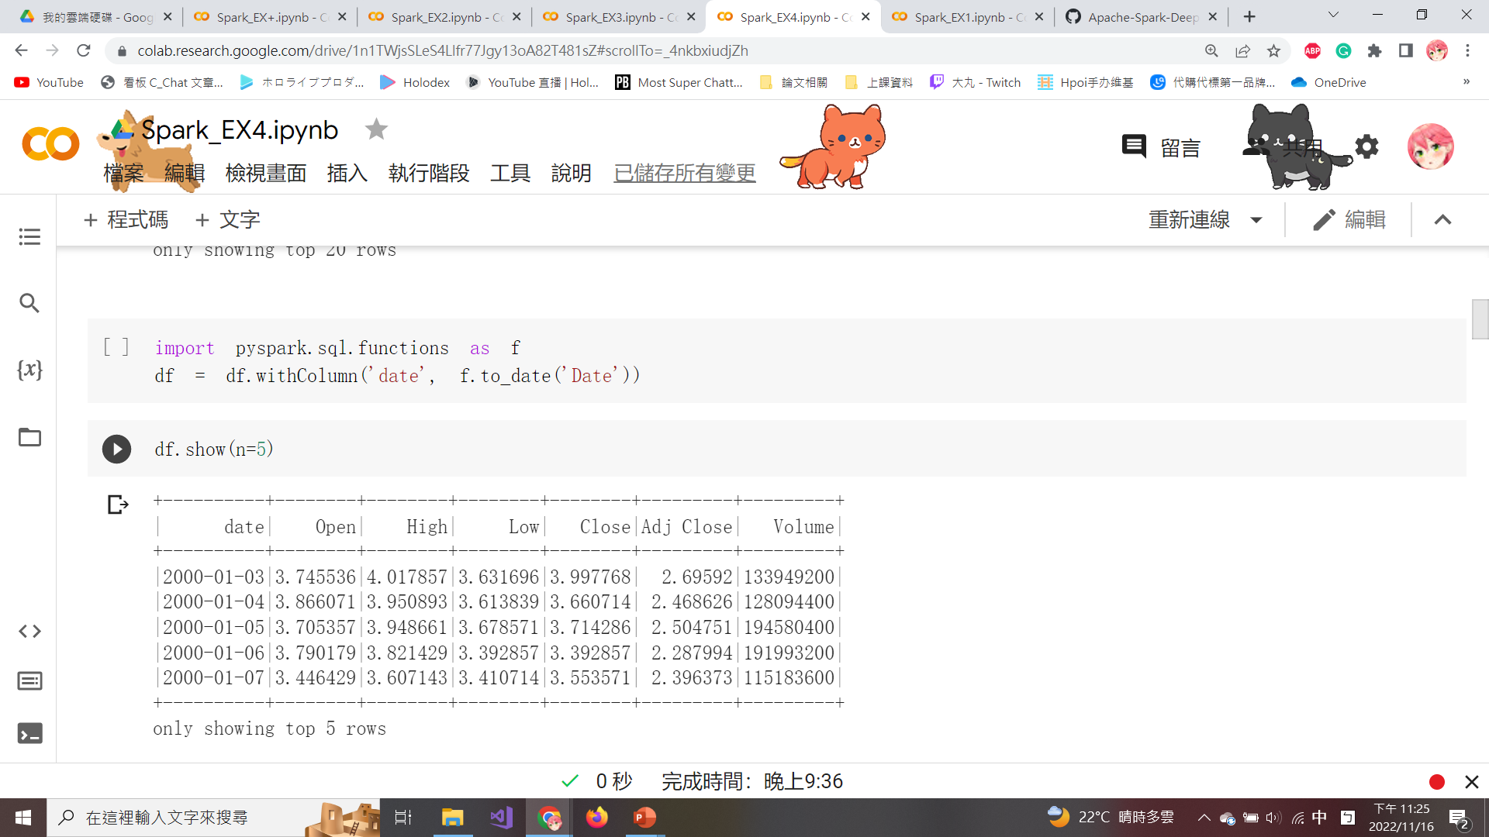
Transform the Format to Date
The ‘Date’ column a date-time format with the time values all ending in 00:00:00.
Use to_date() to transform the ‘Date’ column to date format and use the withColumn() to transform the dataframe.
Notes:
Now, we need to Transform the Date column in the dataframe by removing the timestamp using the following script:
The ‘Date’ column a date-time format with the time values all ending in 00:00:00.
Use to_date() to transform the ‘Date’ column to date format and use the withColumn() to transform the dataframe.
現在，我們需要通過使用以下腳本刪除時間戳來轉換數據框中的日期列：
“日期”列是一種日期時間格式，時間值都以 00:00:00 結尾。
使用 to_date() 將“date”列轉換為日期格式，並使用 withColumn() 轉換數據框。

Slide 56
Transform the Format to Date (Cont’d)
The new ‘Date’ column without the timestamp is shown below.
Notes:
You can see The new ‘Date’ column without the timestamp is shown below.

Slide 57
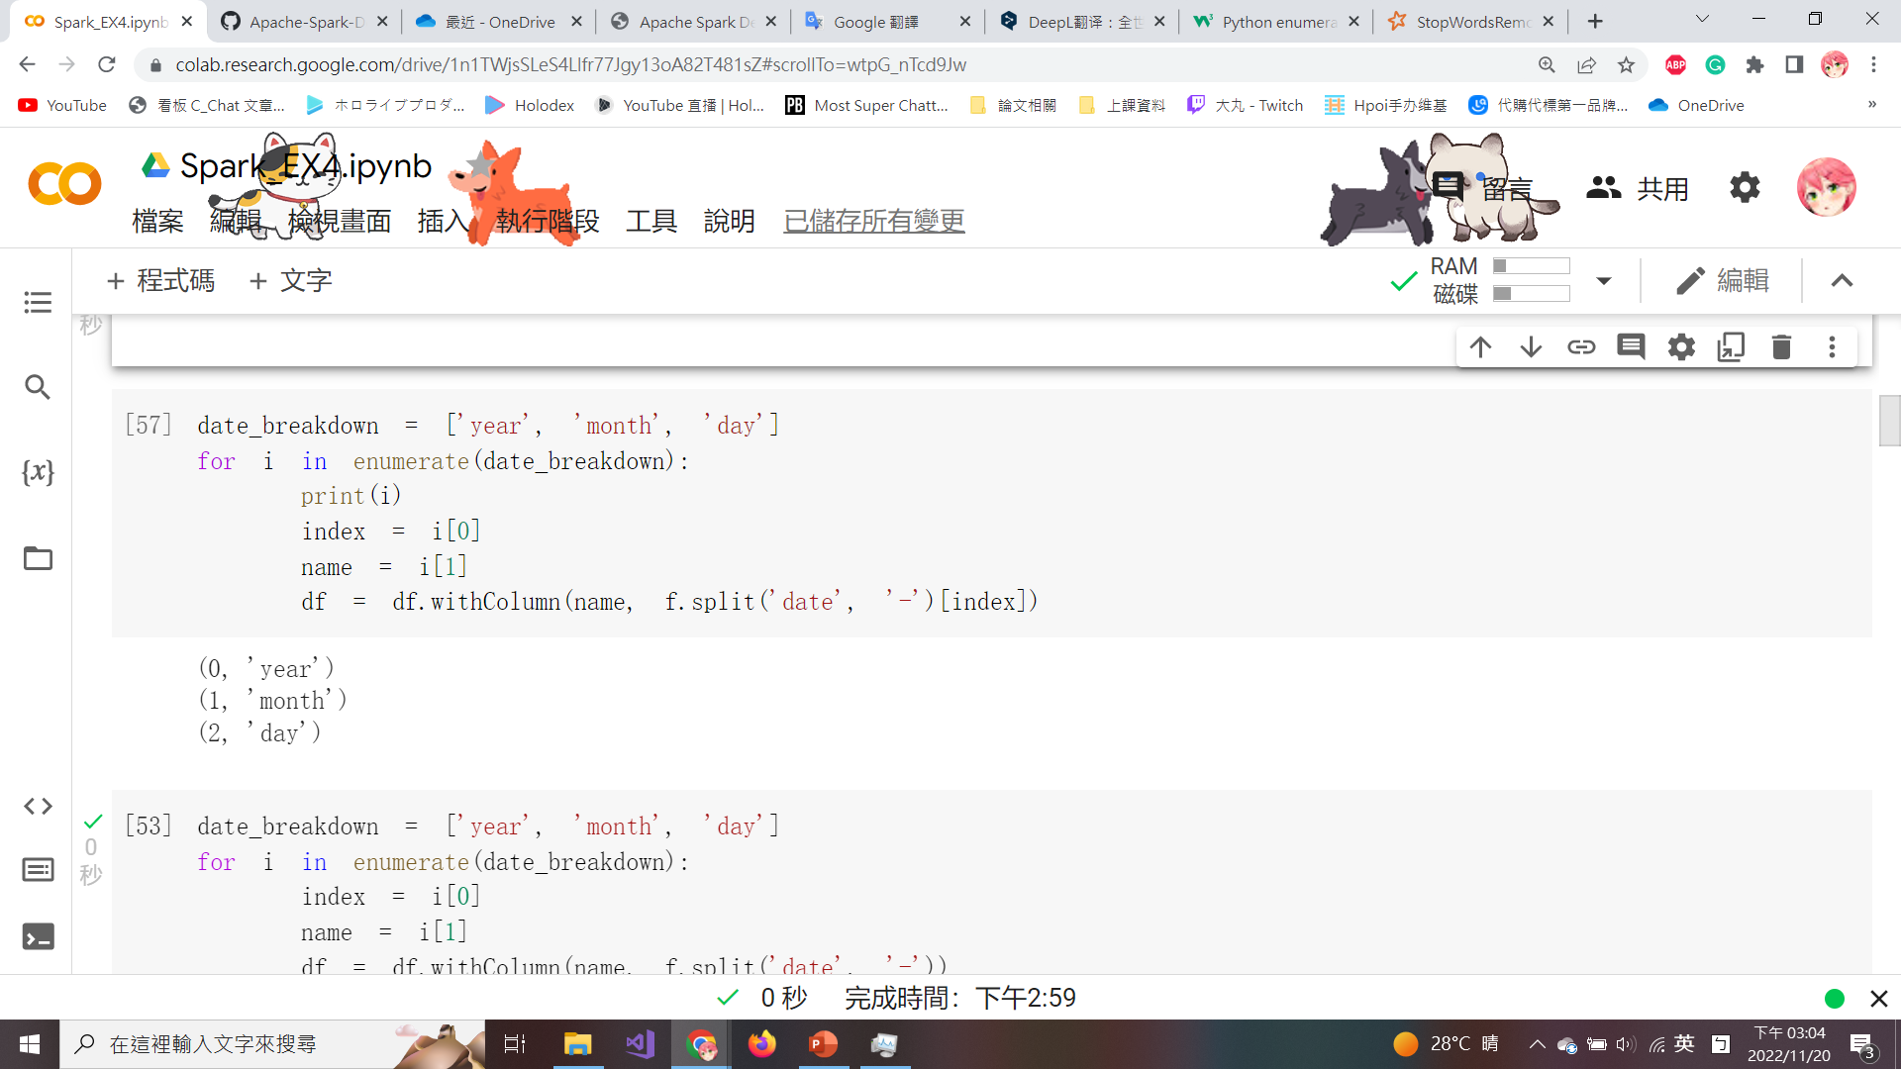
Enumerate and Add the New Column
The enumerate() is used to combine a traversable data object (such as a list) into an index sequence and list the data and its subscripts at the same time, which is generally used in the for loop.
spit() is used to split the date column by a ‘-’ and then use withColumn() to add a new column for the year, month, and day.
Notes:
For analysis purposes, we want to extract the day, month, and year from the date column.
Create a for-cycle to add three additional columns to the dataframe. The loop breaks apart the date field into year, month, and day, as seen in the following script:
The enumerate() is used to combine a traversable data object (such as a list) into an index sequence and list the data and its subscripts at the same time, which is generally used in the for loop.
spit() is used to split the date column by a ‘-’ and then use withColumn() to add a new column for the year, month, and day.
出於分析目的，我們要從日期列中提取日、月和年。
創建一個 for loop以向數據框添加三個額外的列。 該循環將日期字段拆分為年、月和日，如以下腳本所示：
enumerate() 函数用于将一个可遍历的数据对象(如列表)组合为一个索引序列，同时列出数据和数据下标，一般用在 for 循环当中。
spit() 用於通過“-”拆分日期列，然後使用 withColumn() 為年、月和日添加新列。

Slide 58
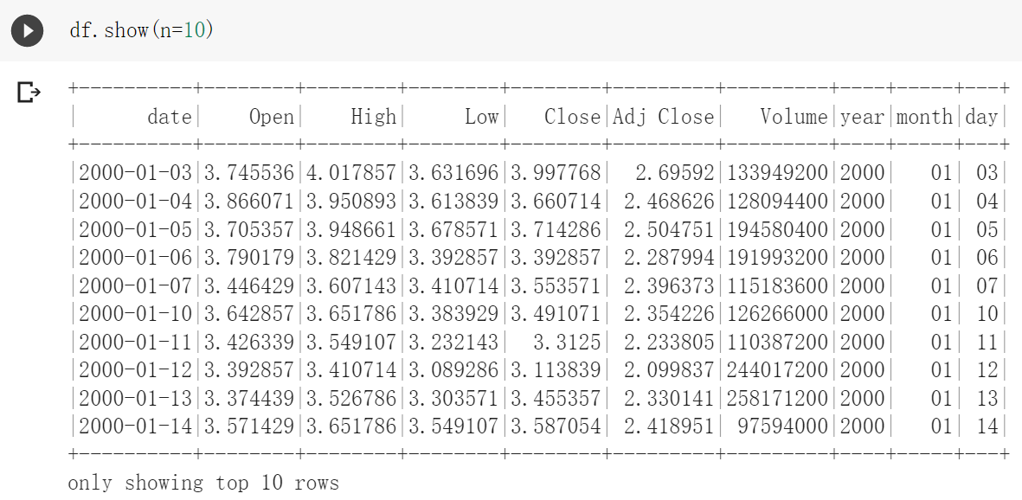
Enumerate and Add the New Column (Cont’d)
The updated dataframe with the newly added columns is shown below.

Slide 59
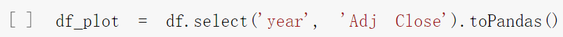
Convert Spark Dataframe to Pandas
Spark dataframes are more limited in visualization features than pandas dataframes.
Convert subset 2 columns ‘year’ and ‘Adj Close’ from Spark dataframe to a pandas dataframe by using toPandas() for plotting a line chart.
Notes:
But, Spark dataframes are more limited in visualization features than pandas dataframes.
Convert subset 2 columns ‘year’ and ‘Adj Close’ from Spark dataframe to a pandas dataframe by using toPandas() for plotting a line chart.
但是，Spark 數據幀在可視化功能方面比 pandas 數據幀更受限制。
使用 toPandas() 繪製折線圖，將子集 2 列“year”和“Adj Close”從 Spark 數據幀轉換為 pandas 數據幀。

Slide 60
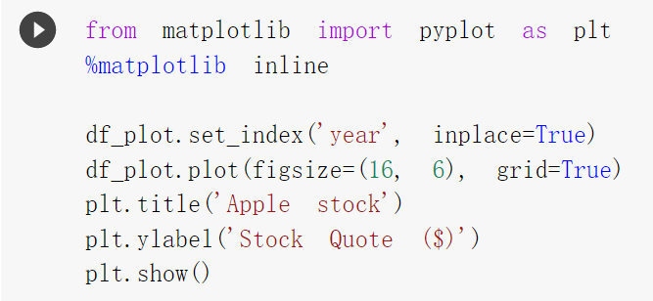
Import matplotlib
matplotlib is a classic library for visualizing data with Python, available for Python development environments such as Google Colab.
set_index(): Set the dataframe index to ‘year’.
plot() which “grid=True” is used to display the grid in the figure.
Notes:
Graph and visualize the pandas dataframe, df_plot, inside of the notebook using the following script:
matplotlib is a classic library for visualizing data with Python, available for Python development environments such as Google Colab.
set_index(): Set the dataframe index to ‘year’.
plot() which “grid=True” is used to display the grid in the figure.
使用以下腳本在筆記本內部繪製和可視化 pandas 數據框 df_plot：
Inplace=‘True’: 是否修改 DataFrame 。

Slide 61

Time-series vs. Stock Quote
The final time-series vs. stock quote plot is shown below.

Slide 62

Remove Null Values
shape function is used to get the count of the (rows, columns).
dropna(): Find the null value of the dataframe, delete the row or column where the null value is located, and return the new dataframe.
Notes:
Next, we Calculate the row and column count of our Spark dataframe.
shape function is used to get the count of the (rows, columns).
Then, Execute the script to determine null values in the datafram
dropna(): find the null value of the dataframe, delete the row or column where the null value is located, and return the new dataframe.
接下來，我們計算 Spark 數據幀的行數和列數。
形狀函數用於獲取（行，列）的計數。
然後，執行腳本以確定數據幀中的空值
dropna()：找到dataframe的空值，刪除空值所在的行或列，返回新的dataframe。

Slide 63

Apple Stock Stats
The row count, mean, standard deviation, minimum, and maximum values of the statistics for Open, High, Low, Close, and Adj Close can be seen in the following screenshot.
Notes:
Execute the following script to pull back statistics on Open, High, Low, Close, and Adj Close:
The row count, mean, standard deviation, minimum, and maximum values of the statistics for Open, High, Low, Close, and Adj Close can be seen in the following screenshot.
執行以下腳本以拉回有關開盤價、最高價、最低價、收盤價和調整收盤價的統計數據：

Slide 64

Get the Number of Trading Days
Use the groupBy() to group the ‘year’ column by the ‘Adj Close’ count to get the total number of stock trading days for each year.
withColumnRenamed() is used to rename the column from ‘count (Adj Close)’ to ‘Row Count’.
Notes:
Next, Execute the following script to group the year column by the count of Adj Close:
Use the groupBy() to group the ‘year’ column by the ‘Adj Close’ count to get the total number of stock trading days for each year.
withColumnRenamed() is used to rename the column from ‘count (Adj Close)’ to ‘Row Count’.
接下來，執行以下腳本以按 Adj Close 的計數對年份列進行分組以顯示每年的交易日數量：

Slide 65

Get the Number of Trading Days (Cont’d)
The dataframe to get a total count of stock trading days per year is shown in the figure.

Slide 66

Training Data & Testing Data
The data between 2017 and 2018 represents approximately 7% of the total data and is used to be testing data.
The remaining 93% of the dataset will be used for training purposes (training data) between 2000 and 2016.
Notes:
Next, Execute the following script to create two new dataframes for training and testing purposes:
The data between 2017 and 2018 represents approximately 7% of the total data and is used to be testing data.
The remaining 93% of the dataset will be used for training purposes (training data) between 2000 and 2016.
接下來，執行以下腳本以創建兩個新的數據幀用於訓練和測試目的:
2017-2018年的數據約佔總數據的7%，用於測試數據。
其餘 93% 的數據集將用於 2000 年至 2016 年間的培訓目的（培訓數據）。

Slide 67
Training Data & Testing Data (Cont’d)
The training dataset (trainDF) contains 4,277 rows.
The testing dataset (testDF) contains 333 rows.
Notes:
Then, we Convert the two new dataframes to pandas dataframes to get row and column counts with toPandas() using the following script:
然後，我們使用以下腳本將兩個新數據幀轉換為 pandas 數據幀，以使用 toPandas() 獲取行數和列數：

Slide 68

Apple’s Stock Price
Use toPandas() to convert the trainDF.
Leverage the built-in graphing capabilities in matplotlib to visualize the data.
Show Apple's stock price from 2000 to 2016.
Notes:
As we did previously with dataframe, we visualize trainDF and testDF using the following script:
Use toPandas() to convert the trainDF.
Leverage the built-in graphing capabilities in matplotlib to visualize the data.
Show Apple's stock price from 2000 to 2016.
正如我們之前對 dataframe 所做的那樣，我們使用以下腳本可視化 trainDF 和 testDF：
使用 toPandas() 轉換 trainDF。
利用 matplotlib 中的內置繪圖功能可視化數據。
顯示 Apple 從 2000 年到 2016 年的股價。

Slide 69

Apple’s Stock Price (Cont’d)
A line chart showing Apple's stock price from 2000 to 2016.

Slide 70

Apple’s Stock Price (Cont’d)
Use toPandas() to convert the testDF.
Leverage matplotlib to visualize the data.
Show Apple's stock price from 2017 to 2018.
Notes:
Next, we Plot Apple's stock price from 2017 to 2018.
接下來，我們繪製 Apple 從 2017 年到 2018 年的股價。

Slide 71

Apple’s Stock Price (Cont’d)
A line chart showing Apple's stock price from 2017 to 2018.

Slide 72

Convert Dataframe to Numpy Array
When working with neural networks, it is best to keep the values between 0 and 1 to match outcomes found in sigmoid or step functions.
We must first convert our pyspark dataframes (trainDF and testDF) into NumPy arrays: trainArray and testArray.
Notes:
We create two new arrays, trainArray and testArray, based on the dataframes with the exception of the date columns using the following script:
When working with neural networks, it is best to keep the values between 0 and 1 to match outcomes found in sigmoid or step functions that are used for activation.
To accomplish this, we must first convert our pyspark dataframes, trainDF and testDF, into numpy arrays, these being trainArray and testArray.
我們使用以下腳本基於除日期列之外的數據幀創建兩個新數組 trainArray 和 testArray：
使用神經網絡時，最好將值保持在 0 和 1 之間，以匹配在用於激活的 sigmoid 或階躍函數中找到的結果。
為此，我們必須首先將 pyspark 數據幀 trainDF 和 testDF 轉換為 numpy 數組，即 trainArray 和 testArray。

Slide 73

Convert Dataframe to Numpy Array (Cont’d)
The first values in ‘trainArray’ and ‘testArray’ are shown below.
Notes:
When Executing the following script The first values in ‘trainArray’ and ‘testArray’ are shown below.
執行以下腳本時“trainArray”和“testArray”中的第一個值如下所示，可以看到Data都沒有介於0和1之間。

Slide 74


Scale Array Values
Scale array values to a range between 0 and 1 which involves using the following formula:
scaled array value = $(array value − min⁡array value) / (max⁡array value − min⁡array value)$.
We can use the MinMaxScaler() from sklearn library to scale both array values in simple.
Notes:
Still, In order to scale the arrays between 0 and 1, we import MinMaxScaler from sklearn and create a function which call MinMaxScale, by using the following script:
Scale array values to a range between 0 and 1 which involves using the following formula:
scaled array value = $(array value − min⁡array value) / (max⁡array value − min⁡array value)$.
We can use the MinMaxScaler() from sklearn library to scale both array values in simple.
為此，為了在 0 和 1 之間縮放數組，我們從 sklearn 導入 MinMaxScaler 並使用以下腳本創建一個調用 MinMaxScale 的函數：
將數組值縮放到 0 到 1 之間的範圍，這涉及使用以下公式：
我們可以使用 sklearn 庫中的 MinMaxScaler() 來代替複雜的方程式，來簡單地縮放兩個數組值。

Slide 75

Scale Array Values (Cont’d)
MinMaxScaler() is fit on the training array and is applied to create 2 brand new arrays, ‘trainingArray’ and ‘testingArray’, that are scaled to values between 0 and 1.
Notes:
MinMaxScaler() is fit on the training array and is applied to create 2 brand new arrays, ‘trainingArray’ and ‘testingArray’, that are scaled to values between 0 and 1 by using the following script:
MinMaxScaler() 適用於訓練數組，並用於創建 2 個全新的數組，“trainingArray”和“testingArray”，使用以下腳本將它們縮放為 0 到 1 之間的值：

Slide 76
Scale Array Values (Cont’d)
The first scaled values in ‘trainingArray’ and ‘testingArray’ are shown below.
Notes:
When Executing the following script The first scaled values in ‘trainingArray’ and ‘testingArray’ are shown below.
可以看到當使用MinMaxScaler() 後，兩個array中的質都被縮放到 0 到 1 之間的範圍。

Slide 77

Values to Train & Test
The first 5 elements in the array are the features as the x-values and the last element is the label as the y-value.
The features are composed of the values from Open, High, Low, Close, and Volume. The label is composed of Adj Close.
xtrain
ytrain
Notes:
Next, for ploting purposes, we Split both testingArray and trainingArray into features, x, and label, y, using the following script:
The first 5 elements in the array are the features as the x-values and the last element is the label as the y-value.
The features are composed of the values from Open, High, Low, Close, and Volume. The label is composed of Adj Close.
接下來，出於繪圖目的，我們使用以下腳本將 testingArray 和 trainingArray 拆分為特徵 x 和標籤 y：
數組中的前 5 個元素 (開高低收成交量)是作為 x 值的特徵，最後一個元素 (收盤價)是作為 y 值的標籤。

Slide 78


Values to Train & Test (Cont’d)
The first row of xtrain, ytrain, xtest & ytest are shown in the figure.
Notes:
The first row of xtrain, ytrain, xtest & ytest are shown in the figure.
第一行xtrain、ytrain、xtest和ytest如圖所示。

Slide 79

Validate the Correctness of Shape
Check the shape of the 4 arrays that will be used in the model to confirm that 5 elements for features (x-values), and one element for the label (y-values), as can be seen in the following figure.
Notes:
Execute the following script to retrieve a final inventory of the shape of all four arrays:
Check the shape of the 4 arrays that will be used in the model to confirm that 5 elements for features (x-values), and one element for the label (y-values), as can be seen in the following figure.
執行以下腳本以檢索所有四個陣列的大小是否正確：
檢查將在模型中使用的 4 個數組的形狀，以確認 5 個元素用於特徵（x 值），一個元素用於標籤（y 值），如下圖所示。

Slide 80

Quotes of xtrain
The values for the training array (xtrain), for open, low, high, and close can be plotted using the newly adjusted scales between 0 and 1.
Notes:
Execute the following script to plot the training array for the quotes open, high, low, and close :
The values for the training array (xtrain), for open, low, high, and close can be plotted using the newly adjusted scales between 0 and 1.
執行以下腳本繪製開盤價、最高價、最低價和收盤價的training array：
訓練數組 (xtrain) 的開盤價、最低價、最高價和收盤價可以使用 0 到 1 之間新調整的比例繪製。

Slide 81

Quotes of xtrain (Cont’d)
The adjusted scales between 0 and 1 for open, low, high, and close, as shown in the figure.
Notes:
The adjusted scales between 0 and 1 for open, low, high, and close, as shown in the figure.
可以看到開盤價、最低價、最高價和收盤價的調整比例在 0 和 1 之間，如圖所示。

Slide 82

Volume of xtrain
The volume can also be plotted with the scaled volume scores between 0 and 1.
Notes:
Additionally, we plot the training array for volume using the following script:
The volume can also be plotted with the scaled volume scores between 0 and 1.
此外，我們使用以下腳本繪製成交量的training array：
並且成交量也可以用 0 到 1 之間的縮放體積分數繪製。

Slide 83

Volume of xtrain (Cont’d)
The adjusted scales between 0 and 1 for volume, as shown in the following figure.
Notes:
The adjusted scales between 0 and 1 for volume, as shown in the following figure.
調整後的成交量其範圍限範圍在 0 到 1 之間，如下圖所示。

Slide 84

Build the Model
Import keras in pyspark to build the LSTM model with models and layers libraries.
The LSTM model will be defined using a Sequential() that works with time series that are sequence-dependent.
Notes:
Next, to build a model we first Import keras in pyspark to build the LSTM model with models and layers libraries.
The LSTM model will be defined using a Sequential() that works with time series that are sequence-dependent.
接下來，為了構建預測模型，我們首先在 pyspark 中導入 keras，以使用model和layer library構建 LSTM 模型。
LSTM 模型將使用 Sequential() 定義。而Sequential() 可以通過將網絡層的list傳遞給 Sequential 的建構器，來創建一個 Sequential 順序模型。順序模型是多個網絡層的線性堆疊

Slide 85
Build the Model (Cont’d)
input_shape = (1,5): One dependent variable and 5 independent variables in the training dataset.
Only one Dense layer will be used to define the neural network.
mean_squared_error calculation is best to determine how close the predicted value is to the actual value.
Optimizer is defined as ‘adam’ which gives good results when being used with recurrent neural networks.
Notes:
You can Build a Sequential model by using the following script:
input_shape = (1,5) for one dependent variable and five independent variables in our training dataset.
In the model Only one Dense layer will be used to define the neural network.
mean_squared_error calculation is best to determine how close the predicted value is to the actual value.
optimizer is also defined when the model is compiled to adjust the weights in the neural network. adam has given good results, especially when being used with recurrent neural networks.
您可以使用以下腳本構建順序模型：
首先模型需要知道它所期望的輸入大小，因此順序模型中的第一層也就是輸入層需要接收關於其輸入大小的信息。
有幾種方法來做到這一點：在這邊我們使用的是使用input_shape傳遞一個 input_shape 參數給第一層。input_shape = (1,5) 對於我們訓練數據集中的一個因變量(調整收盤價)和五個自變量(開高低收成交量)。
在這邊由於LSTM已經被定義為輸入層input layer，並被指定input_shape，我們的Dense則被當作輸出層，由於LSTM layer的維度為一維，因此為了方便運算，我們將Dense的層數也設成一維，但並不一定是一維也可以更改層數。
Loss參數可以幫助我們判斷誤差值，通常的目標就是要使它最小化，loss='mean_squared_error'，就是選擇損失函數（loss Function）的種類。
而optimizer是要調整參數，來使 loss 損失越小越好。Adam的優點主要在於它有做偏置校正，使每次迭代學習率都有個確定範圍，讓參數的更新較為平穩。

Slide 86

Build the Model (Cont’d)
xtrain and xtest are currently two-dimensional arrays, to incorporate them into the LSTM model, they will need to be converted to three-dimensional arrays by using reshape().
Notes:
Next, we are going to Transform the testing and training data sets into three-dimensional arrays using the following script:
xtrain and xtest are currently two-dimensional arrays, to incorporate them into the LSTM model, they will need to be converted to three-dimensional arrays by using reshape().
接下來，我們將使用以下腳本將測試和訓練數據集轉換為三維數組：
xtrain 和 xtest 目前是二維數組，要將它們合併到 LSTM 模型中，需要使用 reshape() 將它們轉換為三維數組。

Slide 87

Train the Model
The model is fit with xtrain and ytrain which batch_size is set to ten with hundred epochs.
Notes:
Next, Fit the model using a variable called loss with the following script:
The model is fit with xtrain and ytrain which batch_size is set to ten with hundred epochs.
接下來，使用以下程式碼將所有training data全部丟進類神經網路中訓練，經過100個Epoch後，取得經過每個epoch其損失函數：
該模型適用於 xtrain 和 ytrain，其中 batch_size 設置為 10，有 100 個 epoch。
Batch Size指的是一次訓練所抓的訓練樣本數。
Epoch是指當所有資料都被用來訓練類神經網路一次，就算1個Epoch。舉例來說，今天有100筆資料，將它們全部丟進類神經網路中訓練，就算是1個Epoch。e的大小影響模型的最佳化程度和速度。

Slide 88

Show the Model
The mean squared error loss in each epoch is visualized.
After the fifth or sixth epoch, we can see that the loss gradually flattens out, as shown in the screenshot on the right-hand side.
Notes:
In this page the result of mean squared error loss in each epoch is visualized.
After the fifth or sixth epoch, we can see that the loss gradually flattens out, as shown in the screenshot on the right-hand side.
在這頁中，每個epoch的mean squared error loss(均方誤差損失)的結果是可視化的。
在第五或第六個 epoch 之後，我們可以看到損失逐漸變平，如右側屏幕截圖所示。

Slide 89

Model Predict
predict() is used in batch processing of large numbers of inputs and generates output predictions for the input samples.
concatenate(): Combine 2 NumPy arrays column-wise by specifying axis=1.
Notes:
Next, Create a new array, call predicted, by using the following scrip, and Combine the predicted array and ytest arrays into a single unified array, called combined_array:
predict() is used in batch processing of large numbers of inputs and generates output predictions for the input samples.
concatenate(): Combine 2 NumPy arrays column-wise by specifying axis=1.
接下來，使用以下腳本創建一個新array，使用 predict()，來進行model predict：
並且為了將預測值和實際股價化成同張圖，我們使用concatenate()：通過指定 axis=1 按列組合 2 個 NumPy 數組
predict() 用於批量處理大量輸入並為輸入樣本生成輸出預測。

Slide 90

Model Predict (Cont’d)
Execute the following code to plot the actual vs. predicted stock prices.
Notes:
Next, Plot a side by side comparison of Actual versus Predicted stock price to compare trends using the following script:
接下來，使用以下腳本繪製實際與預測股價的並排比較，以比較趨勢：

Slide 91

Model Predict (Cont’d)
The predictions are close to the actual stock quotes from 2017-2018, as shown in the following figure.
Notes:
As you can see The predictions are close to the actual stock quotes from 2017-2018, as shown in the following figure.
正如您所看到的，預測與 2017-2018 年的實際股票報價接近，如下圖所示。

Slide 92

Model Predict (Cont’d)
Mean_squared_error is calculated to understand how much deviation is between the predicted and actual stock prices.
As shown in the following figure, we have a mean squared error of 0.0222 or approximately 2.2%.
Notes:
Calculate the mean squared error between the actual ytest versus predicted stock price by using the following script:
Mean_squared_error is calculated to understand how much deviation is between the predicted and actual stock prices.
As shown in the following figure, we have a mean squared error of 0.0222 or approximately 2.2%.
使用以下腳本計算實際股價 ytest 與預測股票價格之間的Mean_squared_error(均方誤差)：
計算 Mean_squared_error 以了解預測股票價格與實際股票價格之間的偏差有多大。
如下圖所示，我們的均方誤差為 0.0222 或大約 2.2%。

Slide 93

Extra Bonus
Download the current Apple stock price from the following website:
https://finance.yahoo.com/quote/AAPL/history
Notes:
從以下網站下載當前 Apple 股票價格：
https://finance.yahoo.com/quote/AAPL/history

Slide 94
Extra Bonus (Cont’d)
Use a line chart to draw the actual stock price in 2022 against your predicted stock price, such as the following picture.
Notes:
用折線圖畫出2022年的實際股價與你預測的股價，如下圖。

Slide 95
Real Estate Value Visualization and Predict with XGBoost
Notes:
Eventually, we are going to introduce you how to predict the Real Estate Value and Visualize it with XGBoost.
So what is XGBoost? XGBoost is an algorithm that has recently been dominating applied machine learning and Kaggle competitions for structured or tabular data.
最後，我們將向您介紹如何使用 XGBoost 預測房地產價值並將其可視化。
那麼什麼是 XGBoost？ XGBoost 是一種算法，最近在結構化或表格數據的應用機器學習和 Kaggle 競賽中佔據主導地位。

Slide 96

Import Needed Library
seaborn is a visualization library required for analysis and plots.
mpt_toolkits contains functions required by Matplotlib.
sklearn is the primary scientific and statistical library required in this section.
Notes:
Install the necessary libraries in this section by using the following code:
seaborn is a visualization library required for analysis and plots.
mpt_toolkits contains functions required by Matplotlib.
sklearn is the primary scientific and statistical library required in this section.
使用以下代碼在本節中安裝必要的庫：
seaborn 是分析和繪圖所需的可視化庫。
mpt_toolkits 包含我們需要用到的 Matplotlib 所需的函數。
sklearn 是本節所需的主要科學和統計庫。

Slide 97

Read the Data from CSV File
The data is read into a Pandas dataframe using the read_csv().
The headers are listed using the list(dataframe) command, as shown below.
Notes:
First, we need to Read the Data from CSV File.
So, The csv data is read into a Pandas dataframe named dataframe using the read_csv() function
And the headers are listed out using the list(dataframe) command, as shown in the following screenshot:
首先，我們需要從 CSV 文件中讀取數據。
因此，使用 read_csv() 函數將 csv 數據讀入名為 dataframe 的 Pandas 數據幀中
並使用 list(dataframe) 命令列出標頭，如以下屏幕截圖所示：

Slide 98

Print the Dataframe
The head of the dataframe can be printed by using the dataframe.head() as shown below.
Notes:
可以使用 dataframe.head() 打印數據幀的頭部，如下所示。

Slide 99

Print the Dataframe (Cont’d)
The tail of the dataframe can be printed by using the dataframe.tail() as shown below.
Notes:
可以使用 dataframe.tail() 打印數據幀的尾部，如下所示。

Slide 100

Print the Dataframe (Cont’d)
describe() is used to obtain basic statistics such as the maximum, minimum, and mean values under each column.
Notes:
describe() is used to obtain basic statistics such as the maximum, minimum, and mean values under each column as shown below.
describe()用於獲取每列下的最大值、最小值、平均值等基本統計信息。

Slide 101

Number of bedrooms
Plot the count of bedrooms with a bar chart.
value_counts(): Return an object containing counts of values.
Notes:
Next, Let’s plot the count of bedrooms in the whole dataset with a bar chart. This is done using the following code:
value_counts(): Return an object containing counts of values.
接下來，讓我們用條形圖繪製整個數據集中的臥室數量。 這是使用以下代碼完成的：
value_counts()：返回包含值計數的對象。
count() is used to count the number of non-NA/null observations across the given axis. It works with non-floating type data as well.
value_counts() function returns Series containing counts of unique values. The resulting object will be in descending order so that the first element is the most frequently-occurring element. Excludes NA values by default.
count() 用於計算給定軸上非 NA/null 觀察值的數量。 它也適用於非浮動類型數據。
value_counts() 函數返回包含唯一值計數的系列。 結果對象將按降序排列，以便第一個元素是最常出現的元素。 默認情況下排除 NA 值。

Slide 102

Number of bedrooms (Cont’d)
The bar chart of bedroom counts are shown below.
Notes:
臥室數量的條形圖如下所示。

Slide 103


Number of bedrooms (Cont’d)
Plot a pie chart of the dataframe by assigning kind='pie'.
Notes:
We can also plot a pie chart of the same data using the following commands:
Plot a pie chart of the dataframe by assigning kind='pie'.
我們還可以使用以下命令繪製相同數據的餅圖：
通過指定 kind='pie' 繪製數據框的餅圖。

Slide 104


Number of Floors
Let’s plot the number of floors in houses that are sold most frequently.
The bar chart is categorized by the number of floors as shown in the figure.
Notes:
Next, Let’s plot the number of floors in houses that are sold most frequently in King County. This can be done by plotting a bar graph using the following commands:
And The bar chart is categorized by the number of floors as shown in the figure.
接下來，讓我們繪製金縣最常售出的房屋的樓層數。 這可以通過使用以下命令繪製條形圖來完成：
按樓層數分類長條圖，如圖所示。

Slide 105

Locations of House Sold
We need to know what locations have the highest number of houses sold.
jointplot(): Draw a plot of 2 variables by using the latitude and longitude variables from the dataset with bivariate and univariate graphs.
Notes:
Next, we need to have an idea of what locations have the highest number of houses sold. We can do this by using the latitude and longitude variables from the dataset, as shown in the following code:
jointplot(): Draw a plot of 2 variables by using the latitude and longitude variables from the dataset with bivariate and univariate graphs.
接下來，我們需要了解哪些位置的房屋售出數量最多。 我們可以通過使用數據集中的緯度和經度變量來做到這一點，如以下代碼所示：
jointplot()：比较两个不同变量的图表，透過數據集中的緯度和經度變量繪製 2 個變量的圖。

Slide 106

Locations of House Sold (Cont’d)
The density of houses sold at different locations, as shown in the figure.
It is clear that some locations see a higher density of house sales compared to others.
Notes:
The density of houses sold at different locations, as shown in the figure.
It is clear that some locations see a higher density of house sales compared to others.
jointplot是可以結合兩個不同變量的圖表，其中長條圖是代表在該經、緯度區間，房屋的數量多寡，透過jointplot()將dataframe中的緯度和經度2個變量繪製成散點圖。
不同位置的房屋銷售密度，如圖所示。
很明顯，與其他地區相比，某些地區的房屋銷售密度更高。

Slide 107


Price vs. Bedroom Numbers
Draw a plot of the price versus the number of bedrooms the house obtained.
We realize that the trends regarding the number of bedrooms in a house are directly proportional to the price of up to 6 bedrooms, and then it becomes inversely proportional.
Notes:
Let's also take a look at how the prices compare for houses with different numbers of bedrooms by executing the following commands:
Draw a plot of the price versus the number of bedrooms the house obtained.
We realize that the trends regarding the number of bedrooms in a house are directly proportional to the price of up to 6 bedrooms, and then it becomes inversely proportional.
我們還可以通過執行以下命令來比較具有不同臥室數量的房屋的價格：
繪製房屋價格與其臥室數量的關係圖。
我們意識到，一棟房子的臥室數量趨勢與最多 6 間臥室的價格成正比，之後反而會下降，然後成反比。

Slide 108

Price vs. Living Area
We observe how the price compares to the living area of all the houses sold.
scatter(): Draw a scatter plot that uses dots to represent values for 2 different numeric variables.
Notes:
Similarly, let’s plot and analyze how the price compares to the living area of all the houses sold. This can be done by using the following commands:
We observe how the price compares to the living area of all the houses sold.
scatter(): Draw a scatter plot that uses dots to represent values for 2 different numeric variables.
同樣，讓我們繪製並分析價格與所有已售房屋的居住面積的比較情況。 這可以通過使用以下命令來完成：
我們觀察價格與所有已售房屋的居住面積的比較情況。
scatter()：繪製散點圖，使用點表示 2 個不同數值變量的值。

Slide 109

Price vs. Living Area (Cont’d)
The price gives us an expected trend of increasing prices with the increasing size of the house.
Notes:
The figure is shown as below.
The price gives us an expected trend of increasing prices with the increasing size of the house.
這張圖顯示了，房屋價格會隨著房子的居住面積增加而呈現上漲的趨勢。

Slide 110


House Conditions vs. Price
On plotting the figure house conditions vs. price, we notice an expected trend of increasing prices with higher house ratings, as shown in the figure.
Notes:
The condition of houses sold gives us some important information as well.
Let's plot houses condition against the prices to get a better idea of the general trends. This is done using the following commands:
On plotting the figure house conditions vs. price, we notice an expected trend of increasing prices with higher house ratings, as shown in the figure.
除此之外，售出房屋的狀況也為我們提供了一些重要信息。
在繪製房屋條件與價格的關係圖時，我們注意到房價隨著房屋評級的提高而上漲的預期趨勢，如圖所示。

Slide 111

Zip Code vs. Price
Using the following commands, we can learn which zip codes have the most house sales in the dataframe.
Notes:
Using the following commands, we can learn which zip codes have the most house sales in the dataframe.
使用以下命令，我們可以了解數據框中哪些郵政編碼的房屋銷售額最高。

Slide 112

Zip Code vs. Price (Cont’d)
We noticed that certain zip codes have a higher density of houses sold compared to other areas.
Compare the house price with zip codes to understand which areas are wealthier neighborhoods.
Notes:
In the figure on the right-hand side we noticed that certain zip codes have a higher density of houses sold compared to other areas.
We can Compare the house price with zip codes to understand which areas are wealthier neighborhoods.
在右側的圖中，我們注意到與其他地區相比，某些郵政編碼的房屋售出密度更高。
我們可以將房價與郵政編碼進行比較，以了解哪些地區是較富裕的社區。

Slide 113

Model Prediction
Since we have 21 columns, it becomes difficult to build models by incorporating all variables in one single model.
Dropping the id and date features from the dataset because they are unnecessary in our predicted model.
Notes:
Begin by dropping the id and date features from the dataset using the following commands.
Since we have 21 columns, it becomes difficult to build models by incorporating all variables in one single model.
Dropping the id and date features from the dataset because they are unnecessary in our predicted model.
首先使用以下命令從數據集中刪除 id 和 date 特徵。
由於我們有 21 列，因此很難通過將所有變量合併到一個模型中來構建模型。
從數據集中刪除 id 和 date 特徵，因為它們在我們的預測模型中是不必要的。

Slide 114

Model Prediction (Cont’d)
After dropping the id and date columns, the new dataframe contains 19 variables, as shown below.
Notes:
After dropping the id and date columns, the new dataframe contains 19 variables, as shown below.
刪除 id 和 date 列後，新數據框包含 19 個變量，如下所示。

Slide 115

Model Prediction (Cont’d)
We want to observe the correlation between price and other variables.
copy(): Copy the variable of house prices into a new dataframe.
Notes:
We want to observe the correlation between price and other variables.
Copy the dependent variable (such as, house prices, in this case) into a new dataframe using the following commands:
copy(): Copy the variable of house prices into a new dataframe.
我們想觀察房屋價格與其他變量之間的相關性。
使用以下命令將因變量（例如本例中的房價）複製到新數據框中，以確定price column資料是正確的：
copy()：將房價變量複製到新的數據框中。

Slide 116

Model Prediction (Cont’d)
The correlation between price and every other variable can be manually found by using corr().
Notes:
Moreover, The correlation between price and every other variable can be manually found by using corr() in the following script:
此外，可以通過在以下腳本中使用 corr() 手動找到價格與所有其他變量之間的相關性：
corr() 用於查找數據幀中所有列的成對相關性。任何 na 值會自動排除。對於DataFrame 中的任何非數據類型列，將忽略該列。

Slide 117
Model Prediction (Cont’d)
Pearson's correlation coefficient is the most commonly used coefficient. The correlation coefficient usually takes on a value between -1 and +1.
A correlation coefficient of +1 means that for every positive increase in one variable, there is a positive increase of a fixed proportion in the other.
A correlation coefficient of -1 means that for every positive increase in one variable, there is a negative decrease of a fixed proportion in the other.
Zero means that for every increase, there isn't a positive or negative increase. The two variables just aren't related.
Notes:
To observe the correlation between price and other variables.
Pearson's correlation coefficient is the most commonly used coefficient. The correlation coefficient usually takes on a value between -1 and +1.
A correlation coefficient of +1 means that for every positive increase in one variable, there is a positive increase of a fixed proportion in the other.
A correlation coefficient of -1 means that for every positive increase in one variable, there is a negative decrease of a fixed proportion in the other.
Zero means that for every increase, there isn't a positive or negative increase. The two variables just aren't related.
觀察價格與其他變量之間的相關性。
皮爾遜相關係數是最常用的係數。 相關係數通常取-1 和+1 之間的值。
+1 的相關係數意味著對於一個變量的每一個正增長，另一個變量都會有一個固定比例的正增長。
相關係數為 -1 意味著一個變量每增加一個正數，另一個變量就會按固定比例負減少。
零意味著對於每一次增長，都沒有正增長或負增長。 這兩個變量只是不相關。

Slide 118

Model Prediction (Cont’d)
The correlation between price and other variables are shown in the following figure.
Notes:
The correlation between price and other variables are shown in the following figure.
價格與其他變量的相關性如下圖所示。

Slide 119

Model Prediction (Cont’d)
The correlation coefficients can be found by using the simplified code that gives the same values.
iloc[] can specify the variable position in a boolean array (from 0 to length-1 of the axis).
Notes:
Besides the preceding method, an easier way to find the correlation between one variable and all other variables (or columns) in a dataframe is done by using just one line in the following manner:
The correlation coefficients can be found by using the simplified code that gives the same values.
iloc[] can specify the variable position in a boolean array (from 0 to length-1 of the axis).
除了前面的方法之外，一種更簡單的方法可以通過以下方式僅使用一行來找到數據框中一個變量與所有其他變量（或列）之間的相關性：
iloc[] 可以指定布爾數組中的變量位置（從 0 到軸的長度-1）。

Slide 120

Model Prediction (Cont’d)
sns.pairplot() will create a grid of axes to plot multi figures that correspond to y-variables (e.g. bedroom and bathroom) and a single row of the x-variable (e.g. price).
Note that ‘price’ is on the x-axis for each plot.
Notes:
The correlation between price and other variables can be plotted using the seaborn library as the following script:
sns.pairplot() will create a grid of axes to plot multi figures that correspond to y-variables (e.g. bedroom and bathroom) and a single row of the x-variable (e.g. price).
Note that ‘price’ is on the x-axis for each plot.
可以使用 seaborn 庫作為以下腳本繪製房屋價格與其他變量之間的相關性：
sns.pairplot() 將創建一個軸網格來繪製對應於 y 變量（例如臥室和浴室）和單行 x 變量（例如價格）的多個圖形。
請注意，“價格”位於每個圖的 x 軸上。

Slide 121


Model Prediction (Cont’d)
bedrooms vs. price
bathrooms vs. price
Notes:
The figure on the left-hand side is the output as bedrooms count in y-axis vs. price in x-axis.
The figure on the right-hand side is the output as bathroom count in y-axisvs. Price in x-axis.
左側的數字是 y 軸臥室數量與 x 軸價格的輸出。
右側的圖是 y 軸與浴室計數的輸出。 x 軸的價格。

Slide 122


Model Prediction (Cont’d)
floors vs. prices
sqft_living vs. prices
Notes:
The figure on the left-hand side is the output as floors count in y-axis vs. price in x-axis.
The figure on the right-hand side is the output as square feet of living area in y-axis vs. Price in x-axis.
左側的圖是 y 軸樓層數與 x 軸價格的輸出。
右側的圖是 y 軸的居住面積平方英尺與 x 軸的價格的輸出。

Slide 123

Model Prediction (Cont’d)
Drop the ‘price’ column from the x_df dataframe and save it into a new dataframe named x_df2.
Use the LinearRegression() in the sklearn library to fit data to train and build regression models.
Notes:
Next, we Drop the ‘price’ column from the x_df dataframe and save it into a new dataframe named x_df2.
And Use the LinearRegression() in the sklearn library to fit data to train and build regression models.
接下來，我們從 x_df 數據框中刪除“價格”列並將其保存到名為 x_df2 的新數據框中。
並使用 sklearn 庫中的 LinearRegression() 來擬合數據以訓練和構建線性回歸模型。

Slide 124
Model Prediction (Cont’d)
Split the dataset with the train_test_split() in sklearn.
train_test_split(): Split arrays or matrices into random train and test subsets.
Fit the model over the training data.
Notes:
Then, Split the dataset into testing data and training data.
We can Split the dataset with the train_test_split() in sklearn library.
train_test_split(): Split arrays or matrices into random train and test subsets.
Next, Fit the model over the training data.
然後，將數據集拆分為測試數據和訓練數據。
我們可以使用 sklearn 庫中的 train_test_split() 拆分數據集。
train_test_split()：將數組或矩陣拆分為隨機訓練和測試子集。
接下來，將模型擬合到訓練數據上。

Slide 125

Model Prediction (Cont’d)
Print the coefficients applying linear regression to the training and testing dataset by using the reg.coef_ command.
Notes:
Print the coefficients applying linear regression to the training and testing dataset by using the reg.coef_ command.
使用 reg.coef_ 命令印出線性回歸模型來應用於訓練和測試資料的係數。

Slide 126

Model Prediction (Cont’d)
View the result of each column prediction in the x_test dataset generated by the linear regression model.
Notes:
You can see the result of each column prediction in the x_test dataset generated by the linear regression model.
View the result of each column prediction in the x_test dataset generated by the linear regression model.
您可以在線性回歸模型生成的 x_test 數據集中看到每一列預測的結果。

Slide 127

Model Prediction (Cont’d)
Print the accuracy of the model by using reg.score().
The accuracy is 70.37%, which is not bad for a linear model as shown in the following screenshot.
Notes:
Print the accuracy of the model by using reg.score().
We can get The accuracy is 70.37%, which is not bad for a linear model as shown in the following screenshot.
使用 reg.score() 打印模型的準確性。
我們可以得到準確率為 70.37%，這對於線性模型來說已經不錯了，如下面的截圖所示。

Slide 128

Model Prediction (Cont’d)
If we want our model to be more accurate, we will have to use a more complex model.
XGBoost is the model we will use in this section to improve the accuracy obtained through linear regression.
Install and import the XGBoost library.
Notes:
If we want our model to be more accurate, we will have to use a more complex model.
XGBoost is the model we will use in this section to improve the accuracy obtained through linear regression.
Install and import the XGBoost library
如果我們希望我們的模型更準確，我們將不得不使用更複雜的模型。
XGBoost 是我們將在本節中使用的模型，用於提高通過線性回歸獲得的精度。
安裝並導入 XGBoost 庫。

Slide 129

Model Prediction (Cont’d)
XGBRegressor(): Generate a Boosting model.
learning_rate: Boosting learning rate.
max_depth: Maximum tree depth for base learners.
Detailed parameter descriptions will be placed in the appendix.
Notes:
Next, we Declare a variable named new_model to store the Boosting model and declare all its hyperparameters using the following command:
XGBRegressor(): Generate a Boosting model.
learning_rate: Boosting learning rate.
max_depth: Maximum tree depth for base learners.
Detailed parameter descriptions will be placed in the appendix.
n_estimators: Number of gradient-boosted trees. Equivalent to a number of boosting rounds.
learning_rate: Boosting learning rate.
gamma: Minimum loss reduction required to make a further partition on a leaf node of the tree.
subsample: Subsample ratio of the training instance.
colsample_bytree: Subsample ratio of columns when constructing each tree.
max_depth: Maximum tree depth for base learners.
接下來，我們聲明一個名為 new_model 的變量來存儲 Boosting 模型，並使用以下命令聲明其所有超參數：
XGBRegressor()：生成一個 Boosting 模型。
learning_rate：模型學習率，避免花費大量時間做收斂。
max_depth：基礎學習者的最大樹深度。
詳細的參數說明將放在附錄中。
n_estimators：梯度提升樹的數量。 相當於若干個boosting輪次。
learning_rate：模型學習率，避免花費大量時間做收斂。
gamma：在樹的葉節點上進行進一步分區所需的最小損失減少。
subsample：訓練實例的子樣本比例。
colsample_bytree：構建每棵樹時列的子樣本比例。
max_depth：基礎學習者的最大樹深度。

Slide 130

Model Prediction (Cont’d)
Split the data into testing and training datasets and fit the new model.
The output is shown below.
Notes:
Then, we need to Split the data into test and training sets and fit the new model to the split data using the following commands.
The output is shown below.
然後，我們需要將數據拆分為測試集和訓練集，並使用以下命令將新模型擬合到拆分後的數據。

Slide 131

Model Prediction (Cont’d)
Import explained_variance_score() to calculate the score of the regression model.
The newly fitted model to predict the house prices which accuracy is 87.34%. This is considered optimal.
Notes:
Finally, use the newly fitted model to predict the house prices and evaluate the new model.
Import explained_variance_score() to calculate the score of the regression model.
After executing the preceding commands, you can see an output like the one shown in the following screenshot:
So, The newly fitted model to predict the house prices which accuracy is 87.34%. This is considered optimal.
最後，使用新擬合的模型預測房價並對新模型進行評估。
導入 explained_variance_score() 來計算回歸模型的分數。
執行上述命令後，您可以看到類似於以下屏幕截圖所示的輸出：
因此，新擬合的模型預測房價的準確率為 87.34%。 這被認為是最佳的。

Slide 132

Extra Bonus 2
According to the graph analysis on page 105, what other information can be observed from the graph besides house prices? And what other variables do you think are suitable for observation using this graph beside the latitude and longitude? Please plot your thought as the following figure and describe your thoughts in detail.
Please directly write your description in the cell in Colab with #.
Notes:
Then, if you complete all the exercises. Here has an extra bonus for you.
The thesis is as follows:
According to the graph analysis on page 105, what other information can be observed from the graph besides house prices? And what other variables do you think are suitable for observation using this graph beside the latitude and longitude? Please plot your thought as the following figure and describe your thoughts in detail.
Please write your description in the cell in Colab.
然後，如果你完成了所有的練習。 這裡有一個額外的獎勵給你。
論文如下：
根據105頁的圖表分析，除了房價，還能從圖表中觀察到哪些信息？ 您認為除了緯度和經度之外，還有哪些變量適合使用此圖進行觀察？ 請將你的想法畫成下圖，並詳細描述你的想法。
請直接在 Colab 的單元格中用 # 寫下您的描述。

Slide 133
Send Your Works
After finishing the extra bonus, please download the code as .ipynb file.
Send your exercise and bonus files to the mail: t110368019@ntut.org.tw
The title of the email should be in the following format: Student ID_Name_Bonus (ex: 109368091_詹景淳_Bonus).
The deadline for this exercise is 12/27/2022.

Slide 134
Thank you!

